Slide 1
Finally, a High End, One Stop, Machine Learning for Trading Strategies Platform

Slide 2
Agenda
1. Trading System Lab Overview
Trading System Lab at a Glance
2. Machine Learning Solutions with TSL
Defining and Finding Solutions with Machine Learning
3. The Partnership: QH/TSL Solutions Overview
QuantFACTORY: Next Generation Algo Trading Solution

Slide 3
Trading System Lab - At a Glance
Trading System Lab
PROVIDING THE TSL ML/AI STRATEGY DESIGN PLATFORM SINCE 2006
Automates the design, testing and code writing of algorithmic trading strategies using Machine Learning
Design thousands of strategies per second, per instance
No programming is required, but it is encouraged!
Automatically stress tests on Blind Data. & Overfit avoidance measures employed
World Class Machine Learning #1 Rated by Futures Truth on Sequestered Data
Clients
Large and small Assets Under Management (AUM) Clients worldwide

Slide 4
The Partnership
QuantHouse/TSL have partnered to provide a full solution
QuantHouse will advertise that they now have a end-to-end Machine Learning Interface to QuantFactory
TSL will advertise that they have an interface to a research, strategy, development, backtesting, and execution framework
Clients will benefit by having a combined solution that includes historical and real-time data
Notes:
sales

Slide 5
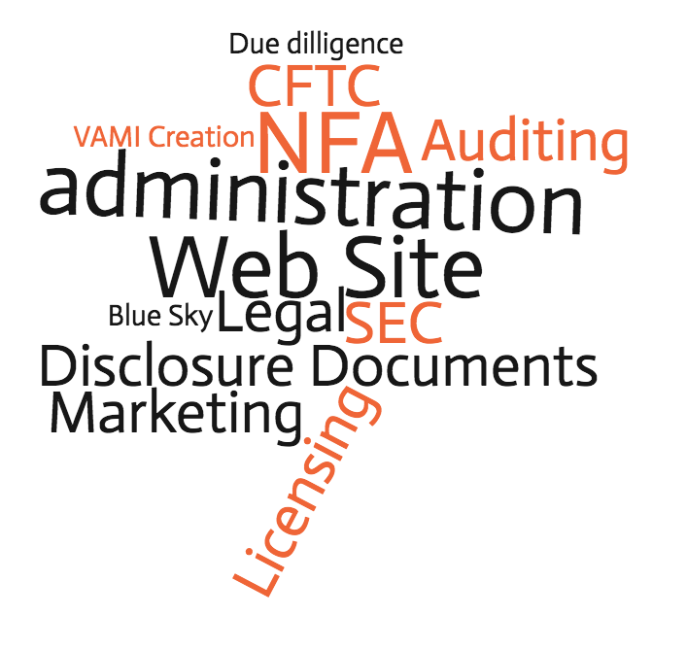
Defining Machine Learning
Why Machine Learning?
Machine Learning for Quants
Machine learning (ML) is the study of computer algorithms that improve automatically through experience
Computers discovering how they can perform tasks without being explicitly programmed to do so
ML is seen as a subset of artificial intelligence
Fund Managers and Traders are Busy, which is why they choose systematic/algorithmic trading.

Slide 6
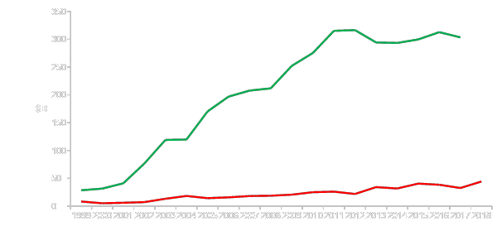
AND SO DO THE BIG $ ALLOCATORS CTA AUM, $B 1999 to 2018
Systematic
(At least 95% Systematic)
QH-TSL are “Systematic”
Discretionary
(At least 65% Discretionary or Judgmental)
394 Sys managers verses 114 Disc managers
Notes:
change to caliri

Slide 7
Machine Learning for Clients
Machine Learning is hot right now. This is an easy way to get started
Manually designing trading strategies takes a lot of time, costs a lot of money and technical skill requirements are high
TSL will make Existing programmers or Quants more efficient
TSL-QH provides for a rapid ML Trading Strategy design
TSL has created a easy to use interface
New Strategy code can be ready within a few minutes or hours.
Back-test verification is done in both TSL and QH
Consulting by TSL and QH is available to ensure a smooth transition

Slide 8
Clients do not have Time to view all ML Algorithms
Supervised learning
AODE
Artificial neural network Backpropagation
Autoencoders
Hopfield networks
Boltzmann machines
Restricted Boltzmann Machines
Spiking neural networks
GE
GA
GP
LGP
LAIMGP *
GEP
CGP
GADS
IFGP
Bayesian statistics Naive Bayes classifier
Bayesian network
Bayesian knowledge base
Case-based reasoning
Decision trees
Inductive logic programming
Gaussian process regression
Gene expression programming
Group method of data handling (GMDH)
Learning Automata
Learning Vector Quantization
Logistic Model Tree
Minimum message length (decision trees, decision graphs, etc.)
Lazy learning
Instance-based learning Nearest Neighbor Algorithm
Analogical modeling
EM
OLS
KRR
PCA
Probably approximately correct learning (PAC)
Ripple down rules, a knowledge acquisition methodology
Symbolic machine learning algorithms
Subsymbolic machine learning algorithms
Support vector machines
Random Forests
Ensembles of classifiers Bootstrap aggregating (bagging)
Boosting (meta-algorithm)
Ordinal classification
Regression analysis
Information fuzzy networks (IFN)
Conditional Random Field
Statistical classification
ANOVA
Linear classifiers Fisher's linear discriminant
Logistic regression
Multinomial logistic regression
Naive Bayes classifier
Perceptron
Support vector machines
Quadratic classifiers
k-nearest neighbor
Boosting
Decision trees C4.5
Random forests
Bayesian networks
Hidden Markov models
Unsupervised learning
Artificial neural network
Data clustering
Expectation-maximization algorithm
Self-organizing map
Radial basis function network
Vector Quantization
Generative topographic map
Information bottleneck method
IBSEAD
Association rule learning
Apriori algorithm
Eclat algorithm
FP-growth algorithm
Hierarchical clustering
Single-linkage clustering
Conceptual clustering
Partitional clustering
K-means algorithm
Fuzzy clustering
DBSCAN
Reinforcement learning
Temporal difference learning
Q-learning
Learning Automata
Monte Carlo Method
SARSA
Deep learning
Deep belief networks
Deep Boltzmann machines
Deep Convolutional neural networks
Deep Recurrent neural networks
Ref: http://en.wikipedia.org/wiki/Machine_learning

Slide 9
TSL WILL SAVE THAT TIME
TSL does not try to predict the market but employs an Expectation based learning process that flips the design process on its head and removes the problems associated with direct prediction.
Machine Learning to Design and write Strategy Code
TRADING SYSTEM LAB
OFFERINGS
Stress Tests on Blind Data During the Design
Emitting novel/unique strategies that human designers could not derive easily
Many Robustness Techniques

Slide 10
TSL Differentiators Compared to all
Other ML/AI Packages
Expectation Based Modeling with No Prediction Variable (unique offering)
World Class Machine Learning
Produces Equity Curves immediately
Up to 200 times faster than other approaches
Code exported in a variety of languages
34 Function Sets-design better solutions
27 Trade Types-efficient ways to enter and exit the market
10 Preprocessors with 56 variables each-huge range of data
41 Fitness Functions-or write your own “fitness function”
EVORUN™: Iterates through the above
DAS™: Design-Time Adjustable Solutions
Instantiate 20+ hyperthreaded packages on one workstation
Substantial overfit avoidance measures

Slide 11
Predictive Modeling Contains a Missing Step
Structured or Unstructured Data.
Time Series Data.
What step is missing here?
Prediction
Machine Learning Model or Artificial Intelligence
This is the output you are trying to predict
Data File for Prediction (Inputs)
Time

Slide 12
What Step is Missing?
The missing step is that there are no equity curves produced until after predictions are produced
Predictive Modeling focuses on R-Squared yet a good R-Squared may produce a poor trading strategy!
Poor workflow: You don’t know the equity curve immediately and you will probably have to redesign anyway
TSL Connects the Learning Machine directly to the Equity Curve Production Engine

Slide 13
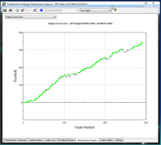
Prediction Approach (OLD)
SpreadSheet and Target Variables
EQUITY
CURVE
Data
Model
Prediction
Expectation
NOT GOOD ENOUGH?
Implement
TSL EXPECTATION APPROACH (NEW)
Data
Expectation
Im
IMPLEMENT
Model
GOOD
ENOUGH?

Slide 14
Main TSL Components
HISTORICAL
DATA
TSL PREPROCESSING
REAL- TIME
DATA
PP Data based on Historical Data
PP Data based on Real Time Data
EVOLVED
CODE
STRATEGY
SIGNAL
GENERATION
QUANTHOUSE
EXECUTION
TSL
EVOLUTION
SIGNAL GENERATION
OOS AND BACKTEST
CODE GENERATION
Copy and
Paste

Slide 15
TSL Example Preprocessing
TSL Preprocessed data files have 56 inputs stored in the V array.
Example:
if close> close[1] then
V[1] = 1
else
V[1] = 0;

Slide 16
TSL Evolved Code
TSL then takes the inputs and combines them with other inputs and math functions
Example resulting code:
L0: f[0]-=v[25];
L1: f[0]+=v[51];
L2: f[0]/=v[55];
L3: result = f[0];

Slide 17
TSL Signal Generation
After Code Evolution, TSL Signals are generated
Example Signal Generation:
if f[0] >=0 and marketposition=0 then go long at market;
if f[0]<0 and marketposition>0 then sell and go flat at market;
Preprocessing, Evolved Code and Signal Generation should produce the same results based on
historical data or real time data

Slide 18
No Prediction?
In TSL, a Strategy is considered an “Object”
That Object has metrics: SR, NET/DD, Total Profit, etc.
TSL uses metrics and combined metrics and a ML to design a Trading Strategy that gets better at trading as it is trading in the Simulation Environment
Export Code when done and implement(Static Solution)
Possible: Continual Learning, during LIVE trading

Slide 19
TSL TYPICAL INPUTS 10 Built In PP’s. Open Code-Fully customizable. 56 Inputs each
Classical and Non-Classical Patterns
1, 2 and more bar patterns
Momemtum Patterns
Countertrend Patterns
Trend Patterns
Gaps and variations
Adaptive boolean patterns
Adaptive numeric pattern relationships
Support and Resistance, adaptations and variations
Detrended pattern effects and variations
Classical and Non-Classical Indicators
Normalized variables
Transforms
Standard Deviation and variations
Averages and variations
Volatility, Volatility Ratios and variations
Adaptive Channels
Regressions and variations
Oscillators and variations
Detrended prices, oscillators and variations
Other DNA:
Intermarket data
Fundamental data
COT
Cycles:MESA, MEM, etc.
Machine readable news
Social Media
Exogeneous Data
Order Book Bid/Ask & Size
Order Book Movement
Order Book Stats

Slide 20
Robustness: Will my Strategy work in the Future?
Forward and Back OOS Testing (Walk either)
Run Path Logs (Path intelligence)
Unbiased Terminal Set (Directionless inputs)
Multi-Run, Randomized Criteria (Global optimum)
Zero Point Origin (No predefined initial point)
Parsimony Pressure (Occam’s razor)
Stat Tests-Distribution is exported (Reject Null)
TTPR, including subsystems (Degrees of Freedom)
Data duration and choice (More is better)
Post Design/Post OOS tests (Second Blind)
Sequestered Data Testing (Extreme testing)

Slide 21
QuantFACTORY Integration
TSL Integrates Here
Notes:
add the diagram from QH/TSL video: capture the screenshot and place in from video. 1:12

Slide 22
Questions
How much will it cost?
TSL License Cost: See TSL Web site for pricing
QuantFactory Cost: Depends on Cloud Back-Testing or Full-Suite. Contact QuantHouse
How long will it take?
A few weeks depending on the requirements
How much will I have to know?
Mike Barna will act as a pre-sale during the pre-qualification process
Questions can be addressed directly to him or to Morgan Dupire
How much will I have to learn?
You will be designing and implementing strategies the same day after installation and initial training. Further Training and consulting will make it easy for you to be productive quickly.
Video for educational purposes as well as documentation

Slide 23
Trading Strategy Design: 3 Simple Steps
Preprocess
Evolve
Translate
[TSL and QH 8 minute video demo link]

Slide 24
Conclusion
Consult the team including Mike Barna, Morgan Dupire, Salloum AbouSaleh, Benoit Mabiala, Joseph Krause, and Stephanie Maurer.
QuantHouse is now at the cutting-edge of data and technology. (HOD + TSL + QuantFactory)
One-stop-solution

