Slide 1
ULTRA FAST GP EVOLVED FINSTRUCTURE FROM UNSTRUCTURED GOO TSL Version 1.1 Review
Michael L. Barna, CTA
Trading System Lab
PLEASE PUT YOUR PHONE ON MUTE
8/16/19

Slide 2
REQUIRED DISCLAIMER
HYPOTHETICAL PERFORMANCE RESULTS HAVE MANY INHERENT LIMITATIONS, SOME OF WHICH ARE DESCRIBED BELOW. NO REPRESENTATION IS BEING MADE THAT ANY ACCOUNT WILL OR IS LIKELY TO ACHIEVE PROFITS OR LOSSES SIMILAR TO THOSE SHOWN.
IN FACT, THERE ARE FREQUENTLY SHARP DIFFERENCES BETWEEN HYPOTHETICAL PERFORMANCE RESULTS AND THE ACTUAL RESULTS ACHIEVED BY ANY PARTICULAR TRADING PROGRAM. ONE OF THE LIMITATIONS OF HYPOTHETICAL PERFORMANCE RESULTS IS THAT THEY ARE GENERALLY PREPARED WITH THE BENEFIT OF HINDSIGHT. IN ADDITION, HYPOTHETICAL TRADING DOES NOT INVOLVE FINANCIAL RISK, AND NO HYPOTHETICAL TRADING RECORD CAN COMPLETELY ACCOUNT FOR THE IMPACT OF FINANCIAL RISK IN ACTUAL TRADING. FOR EXAMPLE, THE ABILITY TO WITHSTAND LOSSES OR TO ADHERE TO A PARTICULAR TRADING PROGRAM IN SPITE OF TRADING LOSSES ARE MATERIAL POINTS WHICH CAN ALSO ADVERSELY AFFECT ACTUAL TRADING RESULTS.
THERE ARE NUMEROUS OTHER FACTORS RELATED TO THE MARKETS IN GENERAL OR TO THE IMPLEMENTATION OF ANY SPECIFIC TRADING PROGRAM WHICH CANNOT BE FULLY ACCOUNTED FOR IN THE PREPARATION OF HYPOTHETICAL PERFORMANCE RESULTS AND ALL OF WHICH CAN ADVERSELY AFFECT ACTUAL TRADING RESULTS.
8/16/19

Slide 3
What is TSL?
TSL is a platform for the automatic design of Trading Strategies
Code is written for you
Trading Strategies are designed for you
Strategies are tested OOS during design
Written by traders (and machine learning scientists, mathematicians, engineers, programmers) for traders
TSL is fast, very fast
TSL’s strategies are #1 as tracked by Futures Truth
TSL has clients in 7 countries
8/16/19

Slide 4
What Does TSL Emphasize?
Transparency
Uniqueness
Robustness
Speed
Portability
Diversity
8/16/19

Slide 5
Transparency
TSL systems can be “White Boxs”
TSL systems show all forward and backtested trades
Systems may be “turned off” at any time
Risk/Stop Loss is completely transparent
Poor Blind Tested Systems are not deployed
8/16/19

Slide 6
Uniqueness
TSL discovers new mathematical relationships
Uses traditional or non traditional information
Stochastic variability in solutions
Simple to Complex behavior may be studied
Fundamentals may be merged with Technicals
Single or Multiple Market-Models deployed
8/16/19

Slide 7
Robustness (Over Fit Avoidance)
Blind Testing (walk forward)
Run Path Logs (path intelligence)
Unbiased Terminal Set (directionless inputs)
Multi-Run, Randomized Criteria (global optimum)
Zero Point Origin (no predefined initial point)
Parsimony Pressure (Occam’s razor)
8/16/19

Slide 8
Speed
Higher Level Languages are too slow
Targeted Fitness is an ENTIRE Trading System
20,000-100,000 Trading Systems needed/run
2.3 Million System-Bars/Second*
<1 minute (10 yrs EOD)
~2-4 minutes (20 yrs EOD)
~5-30 minutes for daytrading system design
Large Terminal Sets are accessed
Large Function Sets are accessed
Intel Core i7 975 15% O.C. Single Thread. N-2NX Core Speedup Possible
Note: this is ~2 orders of magnitude faster than manual evaluators
8/16/19

Slide 9
Portability
Evolves code in:
C
C#
JAVA
ASSEMBLER
TRADE STATION
WEALTH LAB
Other Languages through Translators
Easily to implement in standard trading platforms
Simulator results may be used for further analysis
QuantHouse, TradeStation, WealthLab, Trading Blox, Apollo, others
8/16/19

Slide 10
Diversity
TSL Allows Diversification:
Over Markets
Over Systems
Over Time Frames
GP may assemble disparate blocks
8/16/19

Slide 11
What do I get with TSL?
Unlimited number of systems*
Unlimited number of time frames
Unlimited number of markets
Large selection of languages
Fastest available speed
Huge research capability
*The user builds the systems
8/16/19

Slide 12
PARADIGM SHIFT*
Machines taking on increasing roles on Wall Street
Machine designed strategies are outperforming human designs*
Machines are critical for HF trading
HF Machine Trading is the most profitable category on Wall Street
Machines allow low Latency, Alpha research and generation
Machine inefficient markets exist in emerging countries
Machines will mine world markets for alpha in the future
Machines that are faster and more efficient are in high demand
Customers demand more analysis capabilities in finance and trading
*First time machine designed systems took top ranking in third party blind testing
8/16/19

Slide 13
TRADING AND ALGORITHMS
In 2009, High Frequency Algorithmic trading accounts for 73% of all US equity trading volume, but is conducted by only 2% of the firms
The High Frequency Hedge Fund category is now the most profitable on Wall Street
Futures and options:
- Easy to integrate algos.
- 20% of options volume expected to be algo by 2010
CME quote time is now ~ 6 milliseconds
Clearly, the Futures markets are moving firmly towards Algorithmic trading as we have seen in the equities
References:
Advanced Trading, Sept/Oct. 2009
http://en.wikipedia.org/wiki/Algorithmic_trading
http://www.informationweek.com/news/hardware/data_centers/showArticle.jhtml?articleID=219700577&cid=RSSfeed_IWK_All#
8/16/19

Slide 14
TSL CRITICAL FEATURES
Far faster and better than GA, tree GP’s or other AI
Simultaneous Design/ Walk Forward during design time
56 inputs, full custom inputs possible
5 preprocessed fact sets
34 instruction sets, fully configurable
33 Fitness Functions, includes multi fitness
18 Entry tactics, including multi entry tactics
7 exit tactics, including GP adaptive stops and exits
Risk/Size, Constant dollars embedded and evolved
Money Management and Optional GP “f”
Pairs, full hedge, partial hedge with evolved Money Management
Portfolios, with evolved Money Management
17 Option Tactics and combinations (CRR-BTREE, Bjerk-Stens)
Daytrading-custom ID preprocessing, DT entry/exit types
8/16/19

Slide 15
TSL CRITICAL FEATURES
2.3 Million System-Bars/sec rate (measured Core i7 975)
All time frames, overnight or daytrade
HF, IF or LF systems
C, C#, JAVA, ASSEMBLER, EL, WL, Blox, Others
Max 20 markets in portfolio (Version 1.x)
60,000 bar limit EOD, ID systems (Version 1.x)
10,000 bar limit portfolios (Version 1.x)
8/16/19

Slide 16
The Old Way of Writing Trading Strategies
Develop or use existing theory
Use TA books, indicators, patterns, etc.
Hand code the system
Test, Optimize, Test, Optimize (curve fit?)
Try to select best parameters
Forward walk (maybe?)
Implement and hope for the best
Time of work flow: days to months
8/16/19

Slide 17
The New Way of Writing Trading Strategies
Select Market
Run Strategy generation algorithm
Observe Out of Sample performance
Decide if adequate
Implement
Adjust, research, study, tweak, learn, etc.
Time of work flow: minutes to hours
8/16/19

Slide 18
MACHINE DESIGNED TRADING SYSTEM TECHNOLOGY
A Blend Of:
Technical (and/or Fundamental) Analysis
Data Mining
Evolutionary Algorithms
Trading Simulators
HPC
Note: This is not possible with standard backtesting platforms
8/16/19

Slide 19
REGISTER PROGRAM GENOME STRING
Inputs-DNA(56) Outputs(8)
GP Operators
Function Set
Outputs are used for basic and higher level learning:
Basic trading signals
Complex trading signals
Money management
Adaptive risk
Targets and stops
Optimal GP
8/16/19

Slide 20
CPU CYCLES
How many CPU cycles does it take to compute the following?
X = Y + Z
High level languages: 20 Clock cycles
CGPS(LAIMGP): 1 Clock cycle
So, TSL should be at least 20 times
faster than higher level languages
Reference: Efficient Evolution of Machine Code for CISC Architectures using blocks and Homologous Crossover,
Peter Nordin, Wolfgang Banzhaf, Frank Francone
8/16/19

Slide 21
PREPROCESSING AND THE GOO (Numeric or Boolean)
Example Preprocessing:
? Close >= Close[1]
Result: 0 or 1 (True or False, natural language of machines)
Categories:
News: Machine readable
Market Stack Data
Volatilities
Short term intraday patterns
Support and Resistance
Intermediate term patterns
Long term patterns
Oscillators-OBOS
Filters and Indicators
Regression and deviations
Transforms
Channels
Intermarket/Fundamentals
Domain Expertise-Systems/Ind.
56 Total Inputs. Only a few will be
Selected and used in the final design
by the machine
8/16/19

Slide 22
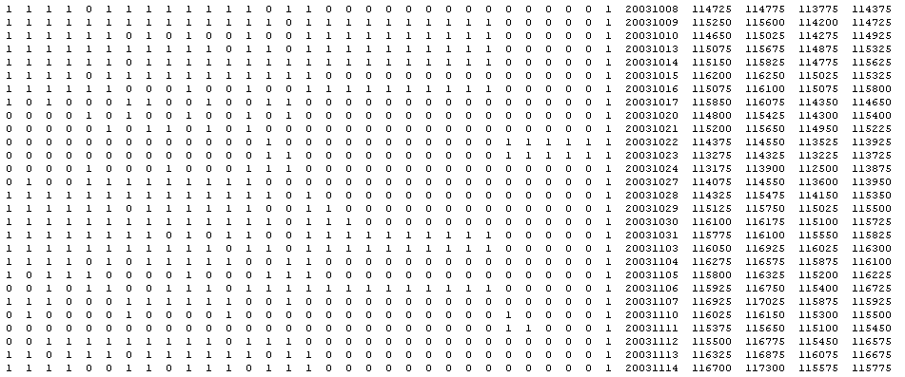
THE GOO Numeric or Boolean
56 inputs + Date, O, H, L, C, Time
(Boolean data shown below)
8/16/19

Slide 23
THE INSTRUCTIONS
Arithmetic Functions:+, -, *, ÷, ABS, SQRT, CHS, SCALE
Transcendental Functions: Trig, Log
Exponential
Stack Rotation
Comparison
Conditional Statements
Jumps
Subroutines-Headers
8/16/19

Slide 24
THE OPERATORS
Crossover: Child shares parents genes
Reproduction: Parent allowed to birth
Mutation: Child genes altered
Demes: Species Interbreed
8/16/19

Slide 25
THE EVOLVED CODE Translated to Easy Language, Wealth Lab, C#, VB, etc.
long double f[8];
long double tmp = 0;
int cflag = 0;
f[0]=f[1]=f[2]=f[3]=f[4]=f[5]=f[6]=f[7]=0;
L0: f[0]-=v[25];
L1: f[0]+=v[43];
L2: f[0]=fabs(f[0]);
L3: f[0]-=v[13];
L4: f[0]-=v[49];
L5: f[0]-=v[41];
L6: f[0]*=f[0];
L7: f[1]-=f[0];
L8: f[0]+=v[22];
L9: tmp=f[1]; f[1]=f[0]; f[0]=tmp;
L10: cflag=(f[0] < f[2]);
L11: f[0]-=v[39];
L12: f[0]+=v[10];
L13: f[0]-=f[1];
L14: if (!cflag) f[0] = f[3];
L15: f[0]+=v[10];
L16: f[0]+=f[0];
L17: f[0]+=f[1];
L18:
if (!_finite(f[0])) f[0]=0;
return f[0];
8/16/19

Slide 26
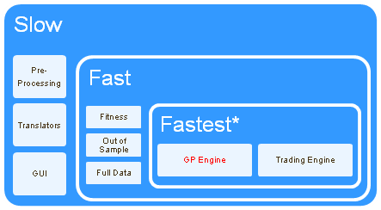
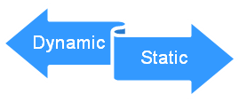
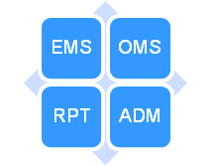
THE ARCHITECTURE Development followed no specific model since no specific model was readily available
Real Time
or
Static Data
Machine
Readable
News
Market
Stack data
Trading System Code
(C#, C++,
JAVA, EL)
*GPU/G80, EP or Many Core Implementations
**VC++.NET, VB, C#, EL
***Assembler, C, C++
8/16/19

Slide 27
ASYNCHRONOUS “WINDOW” MACHINE LEARNING
EVOLVED CODE IS UPDATED BASED ON RT FITNESS
ADAPTIVE
ADAPTIVE
DATA PP WINDOW
EXECUTED
PERFORMANCE
DATA STREAM
FITNESS
TSL
GP
GP
CODE
8/16/19

Slide 28
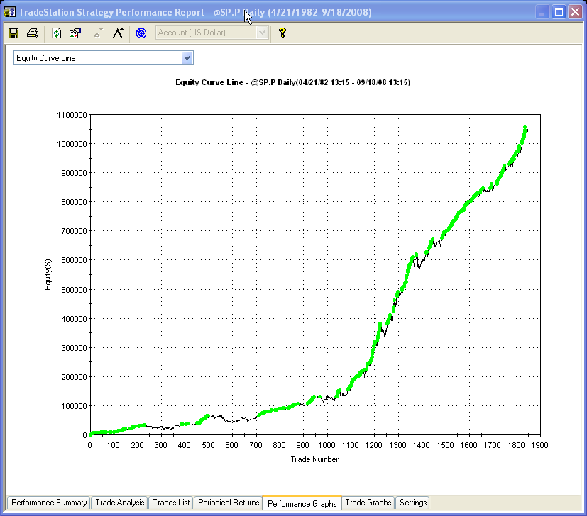
FITNESS CAN BE MULTI GOAL Machine Design Allows Us to Adjust Critical System Metrics as Targeted Fitness Function
Net Profit
Drawdown
Percent Accuracy
Profit Factor
PRODUCES
CODE
Average Trade
8/16/19

Slide 29
EVOLUTIONARY TRADER DESIGN
Traders must trade profitably or they are deleted
Profitable traders compete with other profitable traders
Profitable traders are allowed to reproduce
Some will be subject to random mutations
Offspring will be subject to crossover
Traders will be tested on Out Of Sample* continually
* Blind sample testing during run may reflect “direction” of process
8/16/19

Slide 30
PARAMETER OPTIMIZATION
High risk of over fitting data
Very, very slow
Limits search to preprogrammed sets
Requires an Existing System
8/16/19

Slide 31
Summary of Evolutionary Algorithms
YEAR | INVENTOR | TECHNIQUE | INDIVIDUAL
1958 | Freidberg | Learning Machine | Virtual Assembler
1959 | Samuel | Mathematics | Polynomial
1965 | Fogel, Owens and Walsh | Evolutionary Programming | Automation
1965 | Rechenberg, Schwefel | Evolutionary Strategies | Real-Numbered Vector
1975 | Holland | Genetic Algorithms | Fixed Size Bit String
1978 | Holland and Reitmann | Genetic Classifier Systems | Rules
1980 | Smith | Early Genetic Programming | Var-Size Bit String
1985 | Cramer | Early Genetic Programming | Tree
1986 | Hicklin | Early Genetic Programming | LISP
1987 | Fujiki and Dickinson | Early Genetic Programming | LISP
1987 | Dickmanns, Schmidhuber and Winklhofer | Early Genetic Programming | Assembler
1992 | Koza | Genetic Programming | Tree
8/16/19

Slide 32
TSL GP MARKET COMPARISON
 | TSL-LAIMGP | OTHER (GA/GP)
SPEED | 129 MISBS** | Way Slower
# Inputs* | 56 | 5-?
# Functions | 34 | 5-10
# Entries | 18 | 1-5
# Exits | 4 | 1-3
# Stops | 3 | 1-3
Automatic OOS? | YES | NO
Daytrade? | YES | MAYBE
Pairs? | YES | NO
Portfolio/MM? | YES | MAYBE
Options? | YES | NO
# Preprocessors | 5 | 1
H, Non H Cross? | YES | NO
Third Party Tracked? | YES | NO
*Speed may be proportional to inputs
**Million Input-System-Bars per Second
8/16/19

Slide 33
ES THEORETICAL TRADE PERFORMANCE
For a 1 minute bar, Theoretical EV ~ tick size
However, the period alpha is inverse to interval
Bar Size, Minutes | 405 | 135 | 60 | 15 | 1
Expected Value, $ | 463 | 297 | 188 | 47 | 15
Total Trades/Day | 0.6 | 0.75 | 1.6 | 5.7 | 77
Drawdown | 8300 | 5225 | 4837 | 3062 | 1375
Period Alpha | 277.8 | 222.75 | 300.8 | 267.9 | 1155
Reward/Risk | 0.03 | 0.04 | 0.06 | 0.09 | 0.84
8/16/19

Slide 34
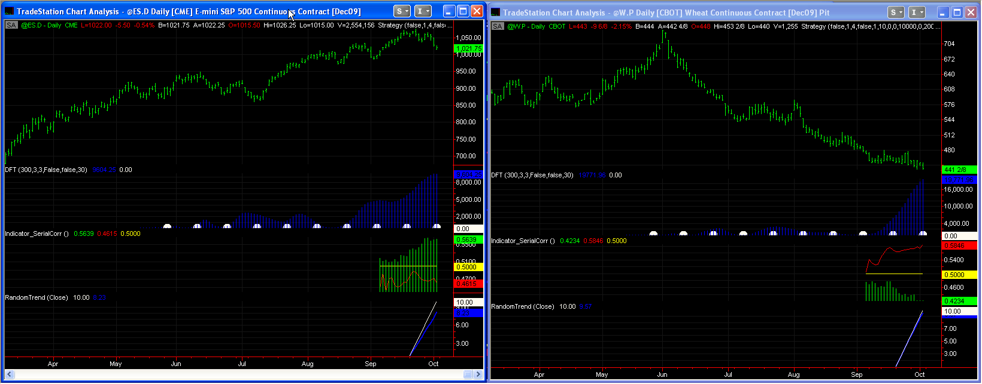
MARKETS HAVE DIFFERENT DESCRIPTIVE STATISTICS So Why Design Symmetrical Systems?
Power Spectral Density
Indicator Serial Correlation
Random Trend
CME:E-MINI S&P
CBOT:WHEAT
8/16/19

Slide 35
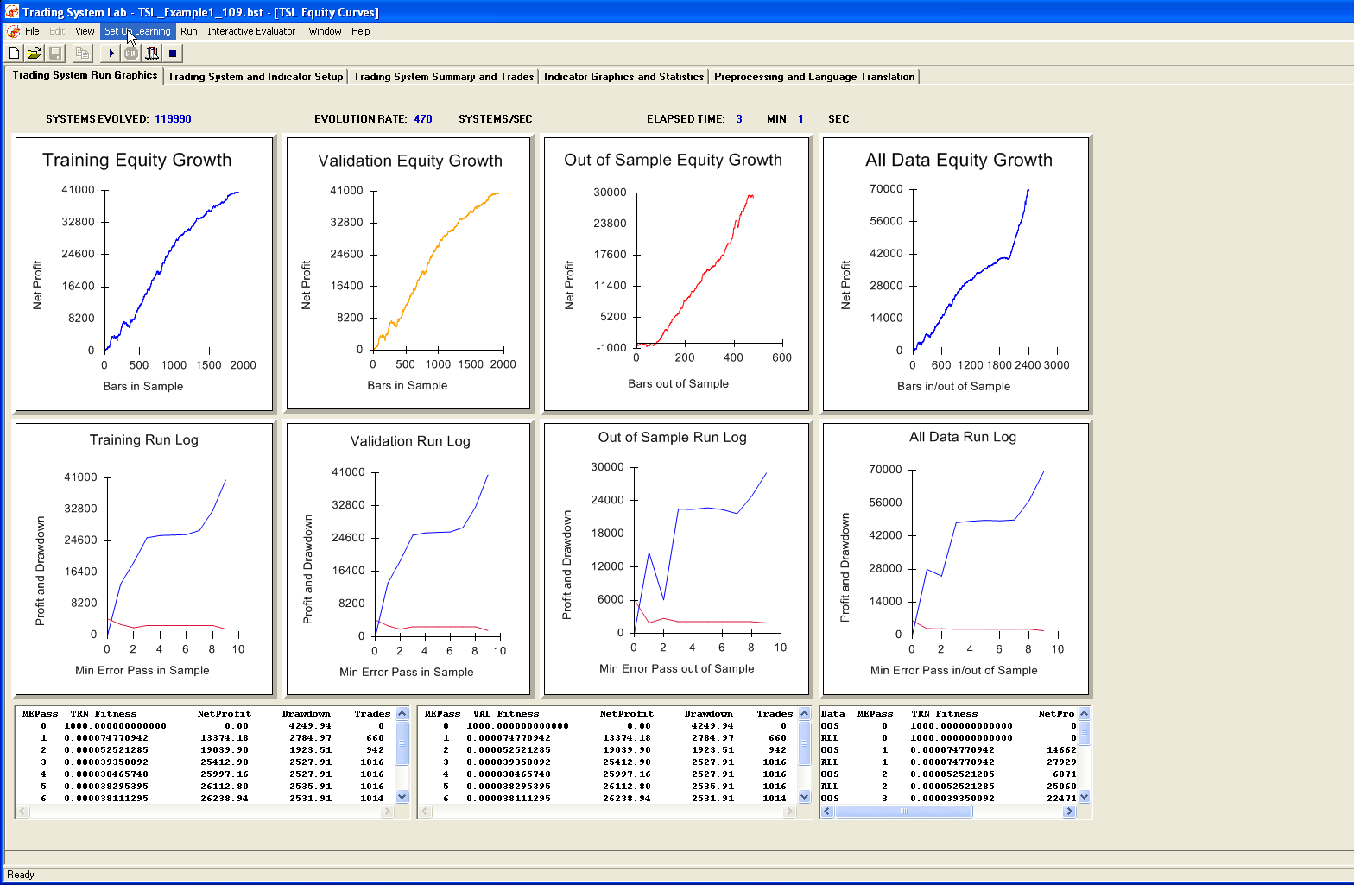
TSL GRAPHICS
8/16/19

Slide 36
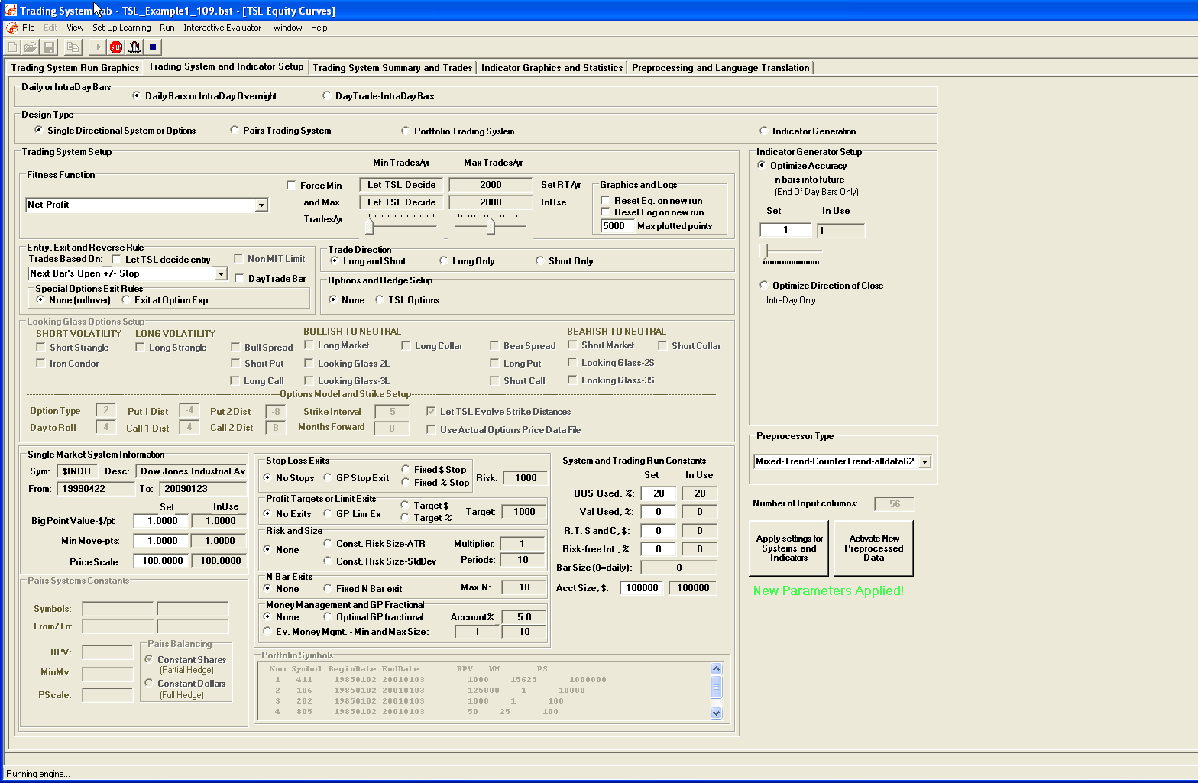
TRADING SYSTEM SETUP
8/16/19

Slide 37
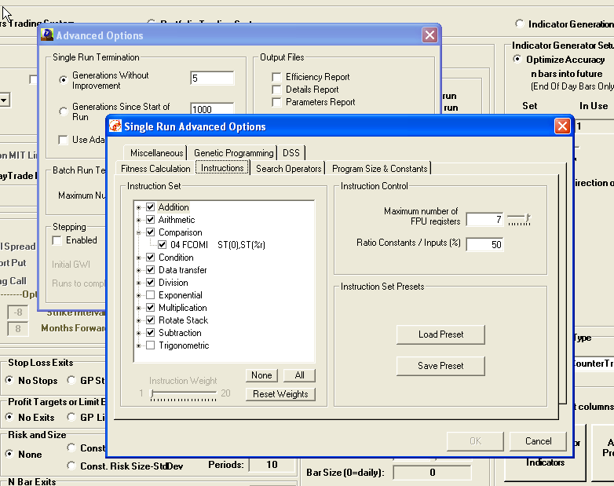
GENETIC PROGRAM SETUP
8/16/19

Slide 38
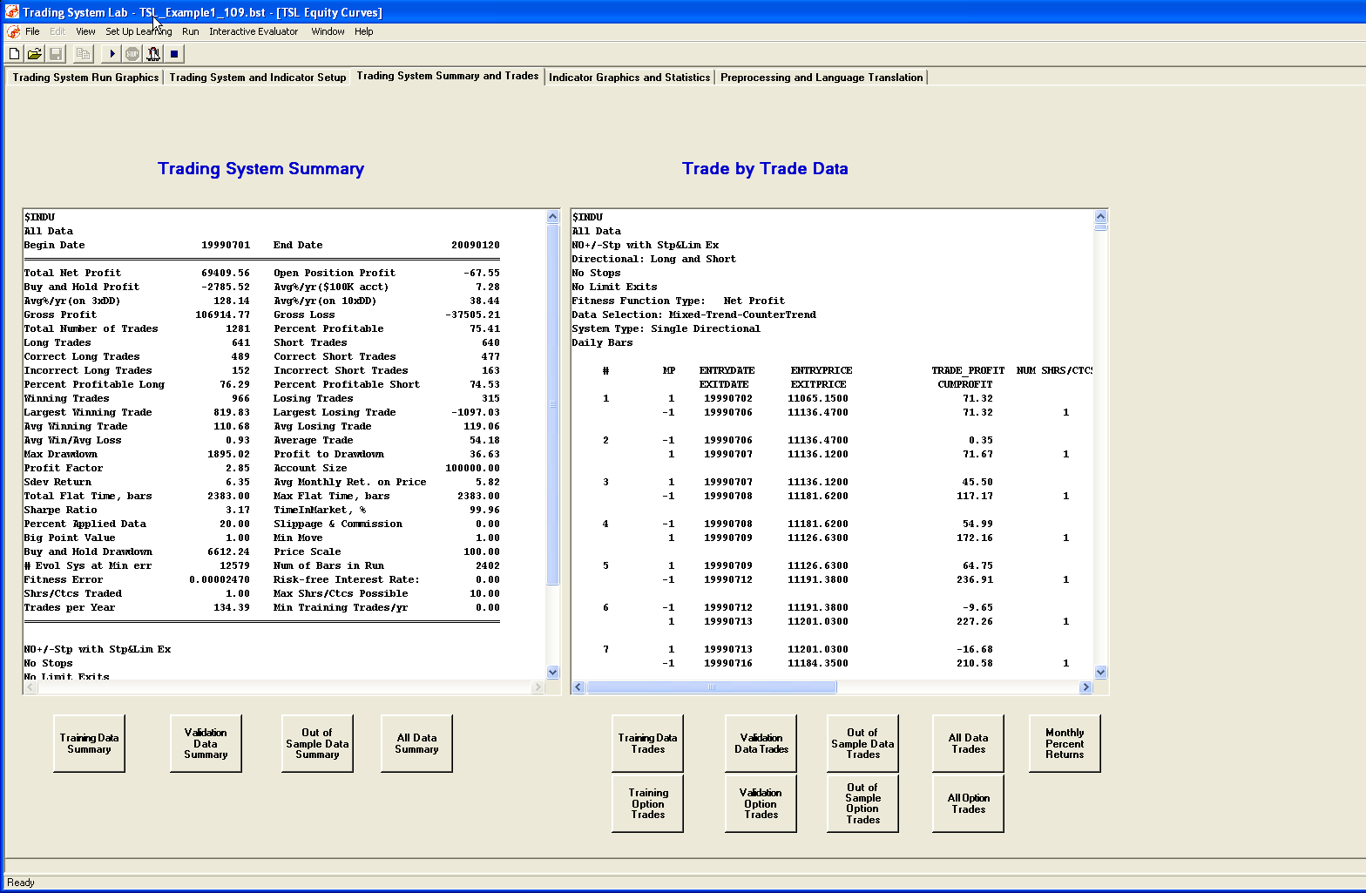
TSL REPORTS
8/16/19

Slide 39
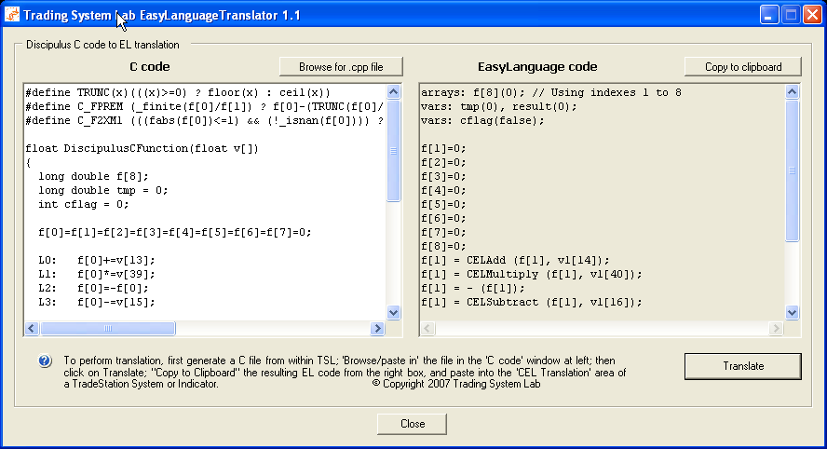
TSL TRANSLATORS
8/16/19

Slide 40
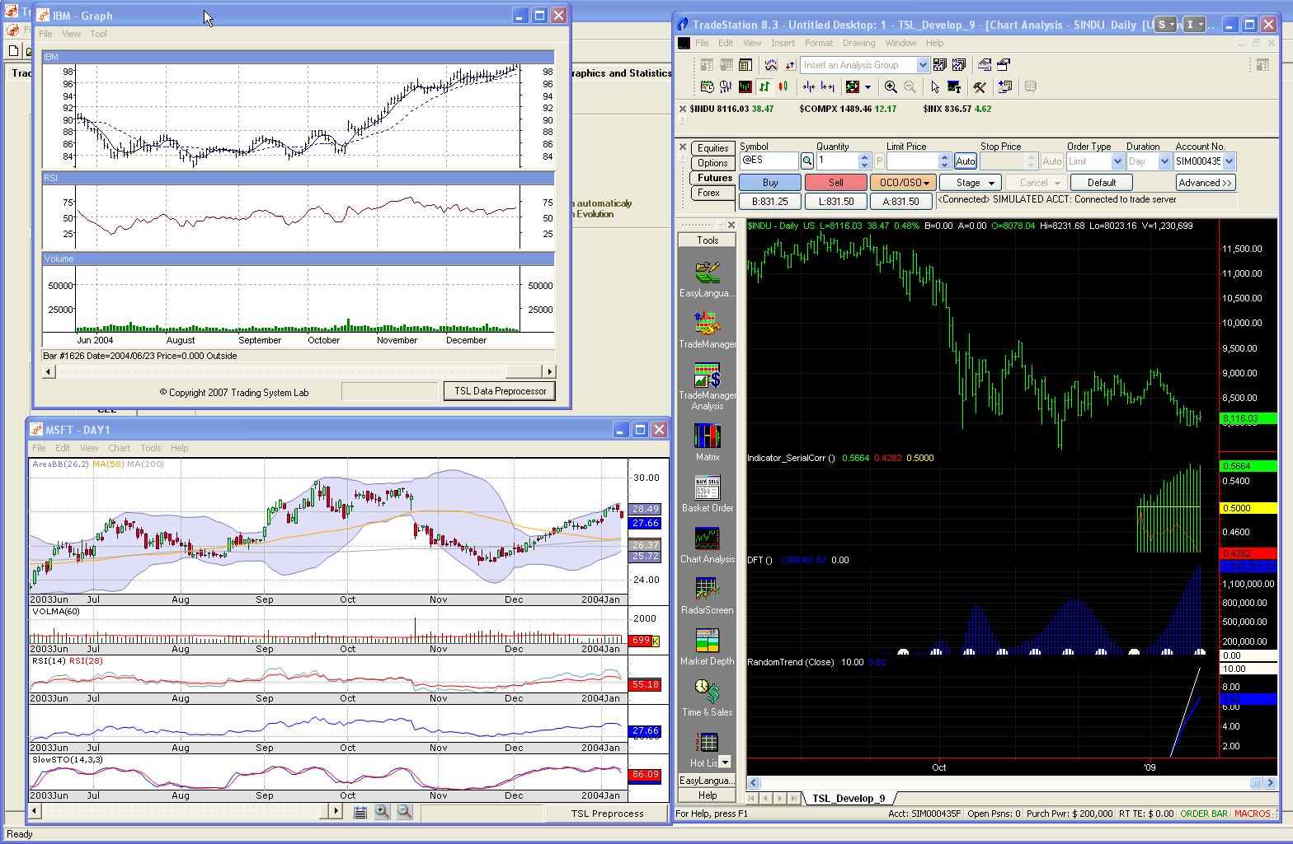
TSL PREPROCESSORS
8/16/19

Slide 41
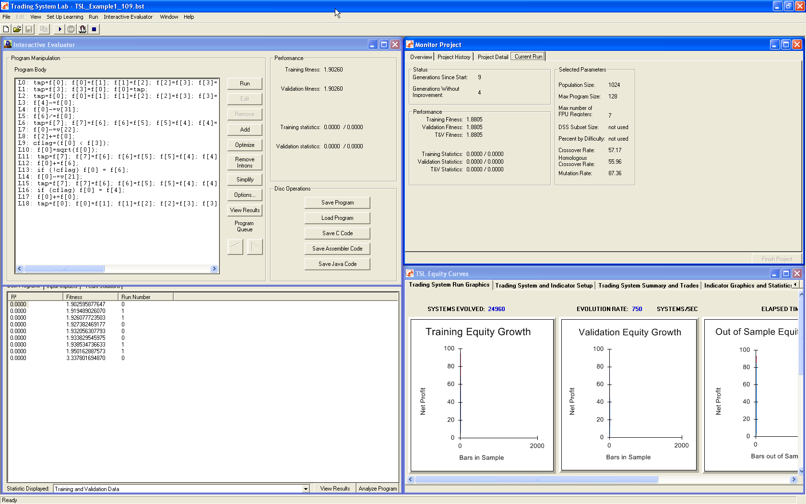
EVOLVED CODE EVALUATOR
8/16/19

Slide 42
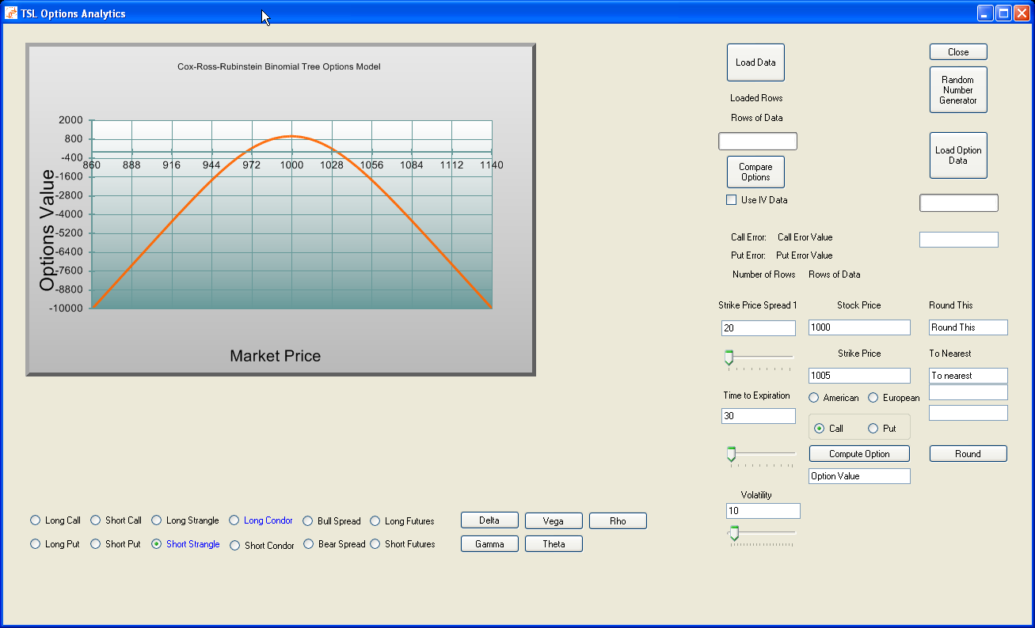
OPTIONS COMBINATIONS GP EVOLVED STRUCTURES
8/16/19

Slide 43
SUMMARY
TSL is patented, trademarked, licensed, restricted and exclusive
TSL produces Daytrading, Pairs, Portfolios, Options and
Single Market Directional Systems
TSL technology is unavailable anywhere else
TSL strategies are #1, per Futures Truth
TSL speed grows with CPU speed
TSL can design many different types of strategies
TSL produces code in a variety of languages
TSL terminal set is customizable
TSL sets a paradigm shift in strategy design
TSL is used in many different countries and on many different markets
8/16/19

Slide 44
FUTURE PLANS
Enhanced front and back end
Strategic partnerships
Hyper threaded simulator
Version 2.x development
Market depth strategy evolution
Asynchronous: “evolution on the fly”
8/16/19

Slide 45
EASY STEPS
Preprocess (TradeStation EL)
Evolve (TSL)
Implement (TradeStation OMS/EMS)
8/16/19

Slide 46
Trading System Lab
End of Part 1
Questions?
8/16/19

Slide 47
CONCLUSION
MACHINE DESIGNED TRADING SYSTEMS ARE HERE!
www.tradingsystemlab.com
408-356-1800
8/16/19

