Slide 1
OPTIONS AND DIRECTIONAL STRATEGIES BASED ON MACHINE LEARNING Derivatives and Equities
Presented to:
SVOG and SVMLTS MeetUp Groups

Slide 2
TODAYS AGENDA
INTRODUCTION TO HUMAN DESIGNED MECHANICAL TRADING STRATEGIES (30min)
INTRODUCTION TO AI DESIGNED TRADING STRATEGIES (30min)
Break (15min)
USING TSL TO DESIGN TRADING STRATEGIES (30min)
OPTIONS STRATEGY DESIGN USING ML AND BID/ASK VALIDATION TESTING(15min)
VIEWS FROM A GUEST SPEAKER (15min)

Slide 3
MEETUP RULES
HOLD YOUR QUESTIONS UNTIL A BREAK POINT HAPPENS
THERE IS NO HOLY GRAIL
www.tradingsystemlab.com
mike@tradingsystemlab.com
408-356-1800

Slide 4
YOUR PRESENTER: MIKE BARNA, CTA
Founder and President, Trading System Lab
Co-Founder and Sr.VP Regency Stocks and Commodities Fund:
LP,LLC, QEP, CPO, CTA
Series 3, Series 30 licenses, CTA
Public Systems Designed: R-MESA, BIGBLUE, MESA BONDS/NOTES
BS Mathematics, Arizona State University
MS Astronautical and Aeronautical Engineering, Stanford University
Former Defense Industry Rocket-Ramjet, Laser and Guidance Engineer
Lockheed, United Technologies, Hughes Aircraft
Star Wars Research and Development Management Engineer
13 FAA pilot certificates or ratings; UAS/Drone Pilot, Ham License: KM6IVI
Current B-757 Captain for a US Major International airline
Contact: www.tradingsystemlab.com mike@tradingsystemlab.com 408-356-1800

Slide 5
OUR DIVISION LEADERS
Mike Barna: Trading System Lab-Silicon Valley Based trading research and development company with a team of international and domestic programmers, third party developers and testers. Developed the First Commercially available Machine Designed Trading Systems Platform that requires no programming from the user.
www.tradingsystemlab.com
Frank Francone: Register Machine Learning, Inc.-US Based company with a team of international and domestic machine learning scientists, IP attorneys, statisticians and programmers. Involved in government contracts. Produces the LAIMGP licensed exclusively to TSL. Authored the leading University Textbook on GP. 1600 citations.
www.rmltech.com

Slide 6
TSL CLIENTS AND TRADERS TSL’s JOB IS TO PROVIDE TSL TO CLIENT TRADERS
Major Wall Street Investment Bank Trader >$100M
Large International Traders and Funds
Small and Mid size CTA’s: $10M-$100M
Proprietary Trading Firms: $5M-$50M
Individual Traders < $5M
Strategy Development Engineers
Beginner to PhD

Slide 7
WHAT IS MY JOB?
Conceive, develop and improve advanced Machine Learning Platforms and Algorithms for trading and investing
Support and train existing TSL clients
Communicate to others my views on the future of Machine Learning as applied to financial markets
Manage the TSL Company

Slide 8
REQUIRED DISCLAIMER
HYPOTHETICAL PERFORMANCE RESULTS HAVE MANY INHERENT LIMITATIONS, SOME OF WHICH ARE DESCRIBED BELOW. NO REPRESENTATION IS BEING MADE THAT ANY ACCOUNT WILL OR IS LIKELY TO ACHIEVE PROFITS OR LOSSES SIMILAR TO THOSE SHOWN.
IN FACT, THERE ARE FREQUENTLY SHARP DIFFERENCES BETWEEN HYPOTHETICAL PERFORMANCE RESULTS AND THE ACTUAL RESULTS ACHIEVED BY ANY PARTICULAR TRADING PROGRAM. ONE OF THE LIMITATIONS OF HYPOTHETICAL PERFORMANCE RESULTS IS THAT THEY ARE GENERALLY PREPARED WITH THE BENEFIT OF HINDSIGHT. IN ADDITION, HYPOTHETICAL TRADING DOES NOT INVOLVE FINANCIAL RISK, AND NO HYPOTHETICAL TRADING RECORD CAN COMPLETELY ACCOUNT FOR THE IMPACT OF FINANCIAL RISK IN ACTUAL TRADING. FOR EXAMPLE, THE ABILITY TO WITHSTAND LOSSES OR TO ADHERE TO A PARTICULAR TRADING PROGRAM IN SPITE OF TRADING LOSSES ARE MATERIAL POINTS WHICH CAN ALSO ADVERSELY AFFECT ACTUAL TRADING RESULTS.
THERE ARE NUMEROUS OTHER FACTORS RELATED TO THE MARKETS IN GENERAL OR TO THE IMPLEMENTATION OF ANY SPECIFIC TRADING PROGRAM WHICH CANNOT BE FULLY ACCOUNTED FOR IN THE PREPARATION OF HYPOTHETICAL PERFORMANCE RESULTS AND ALL OF WHICH CAN ADVERSELY AFFECT ACTUAL TRADING RESULTS.

Slide 9
CAN TODAYS TRADER COMPETE WITH THE BIG BOYS?
Hedgers lose money on trading positions
AI tooling producing good designs is now available to retail traders
Tradable inefficiencies are possible at many trading frequencies
Reasonably priced trading infrastructures are available
Unlimited possible trading approaches may be exploited
Allocators are clearly investing in the mechanical trading strategies, and similar strategies are available to you

Slide 10
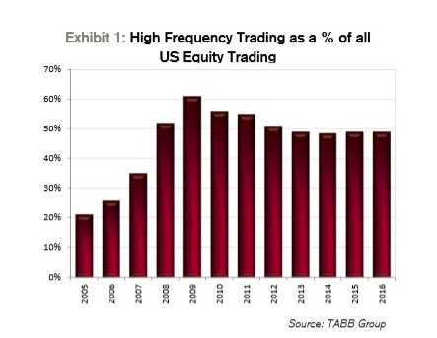
HFT VOLUME 2005 to 2016

Slide 11
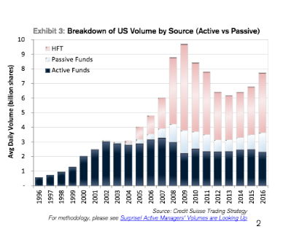
HFT, ACTIVE AND PASSIVE 1996 to 2016

Slide 12
IS HFT REALLY THE BAD GUY OR ARE TRADERS JUST PLAIN BAD?
HFT is a Speed Game, going after the scraps*
Most Day-Traders Lose Money
It’s difficult to beat the basic market returns
It’s difficult to swallow market crashes or flashes
Actively managing your own money is difficult
Most professional managers do not beat the market
Most FOREX traders lose money
Less than 10% of actively managed accounts beat the S&P 500 index fund**
**Source: Research SPIVA® US SCORECARD 2003 – 2016
*NYSE Special Order Types

Slide 13
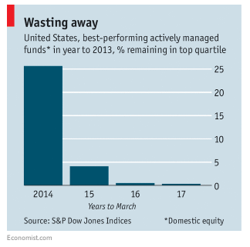
STAY WITH YOUR CURRENT BEST MANAGER?

Slide 14
WHAT IS MACHINE LEARNING?
Machine learning is a field of computer science that gives computers the ability to learn without being explicitly programmed.
Ref: https://en.wikipedia.org/wiki/Machine_learning

Slide 15
QUESTION 1:
What do Microsoft, Google, Facebook, IBM, Amazon and Apple have in common?

Slide 16
QUESTION 1:
What do Microsoft, Google, Facebook, IBM, Amazon and Apple have in common?
They are all investing in AI and ML.

Slide 17
QUESTION 2:
If you do not have a statistically sound, mechanical
trading strategy, designed by AI or human, then
what do you have?

Slide 18
QUESTION 2:
If you do not have a statistically sound, mechanical
trading system, designed by AI or human, then
what do you have?
You have a guess
However, the allocators are not guessing

Slide 19
SYSTEMATIC VERSES DISCRETIONARY CTA MUM, $B 1999 to 2017
Systematic
(At least 95% Systematic)
Discretionary
(At least 65% Discretionary or Judgmental)

Slide 20
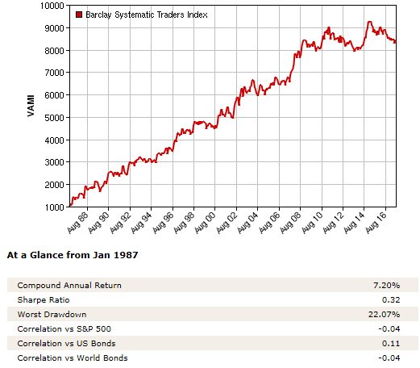
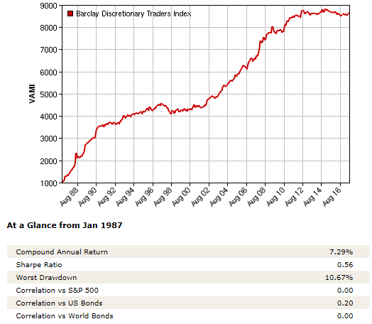
SYSTEMATIC VERSES DISCRETIONARY TRADERS 1987 to 2017
Source: BarclayHedge

Slide 21
EVOLVING TO MECHANICAL SYSTEM TRADING
TRADER STYLE | TRADER COMPLEXITY
DISCRETIONARY No system testing | HIGH Multiple time frames, indicators, conditions, interpretations and setups
METHODOLOGY Minimum system testing | MEDIUM Uses computers to simplify observation of setups
SYSTEMATIC Extensive system testing | LOW Authorizes broker to trade system

Slide 22
EVOLVING TO ML BASED SYSTEM TRADING
TRADER STYLE | TRADER COMPLEXITY
AI/ML BASED Extensive system design and testing | MEDIUM Trader Auto-Designs and Tests System

Slide 23
WE WILL BE STUDYING SOME SINGLE MARKET DIRECTIONAL STRATEGIES
Q: How is this relevant to Options Based Strategies?
A: A directional strategy can be traded with options
Example: Long only directional strategy:
Buy Calls
Sell Puts
Credit/Debit Spread

Slide 24
WE WILL BE STUDYING SOME SINGLE MARKET DIRECTIONAL STRATEGIES
Example: Short a VIX related underlying-Volatility decay
Short Strangle
Iron Condor

Slide 25
A TIME DECAY OF A OPTIONS POSITION
IS NOT A BACKTEST!

Slide 26
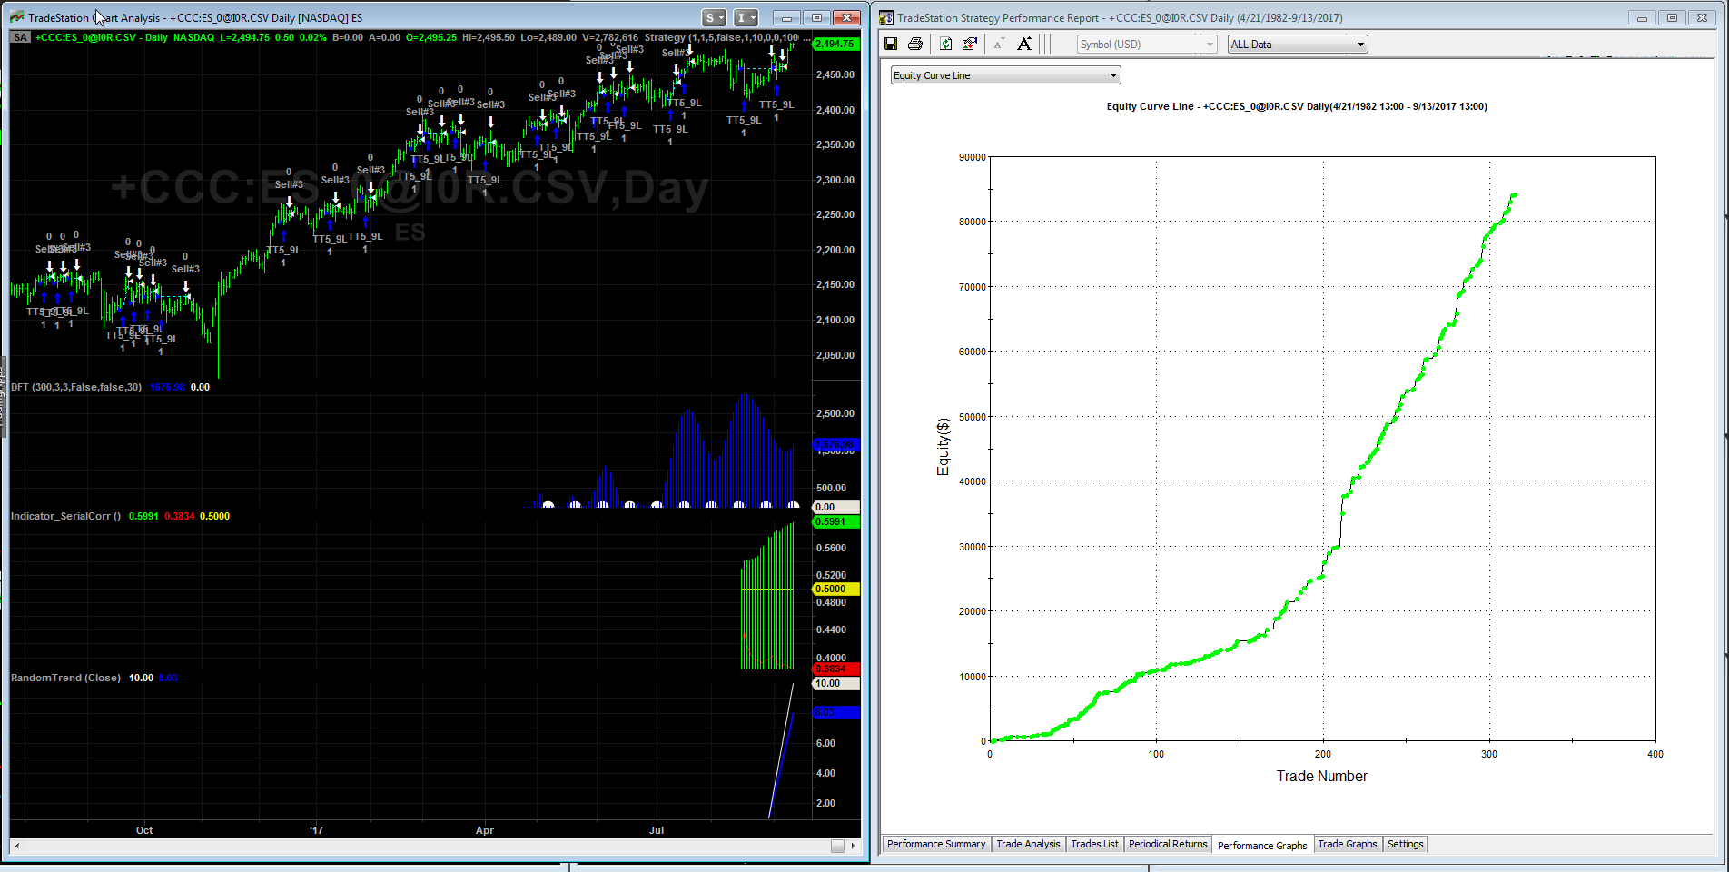
WHAT IS A TRADING SYSTEM EQUITY CURVE?
TRACK AND TRADE
OOS
IN SAMPLE
S&P Futures 1982-2017. Long only, TT5, PP1, FF4, GPex

Slide 27
TO DESIGN A TRADING STRATEGY START BY UNDERSTANDING YOUR MARKET MOVEMENT DYNAMICS
Let’s look at some
TSL Descriptive Statistical Indicators

Slide 28
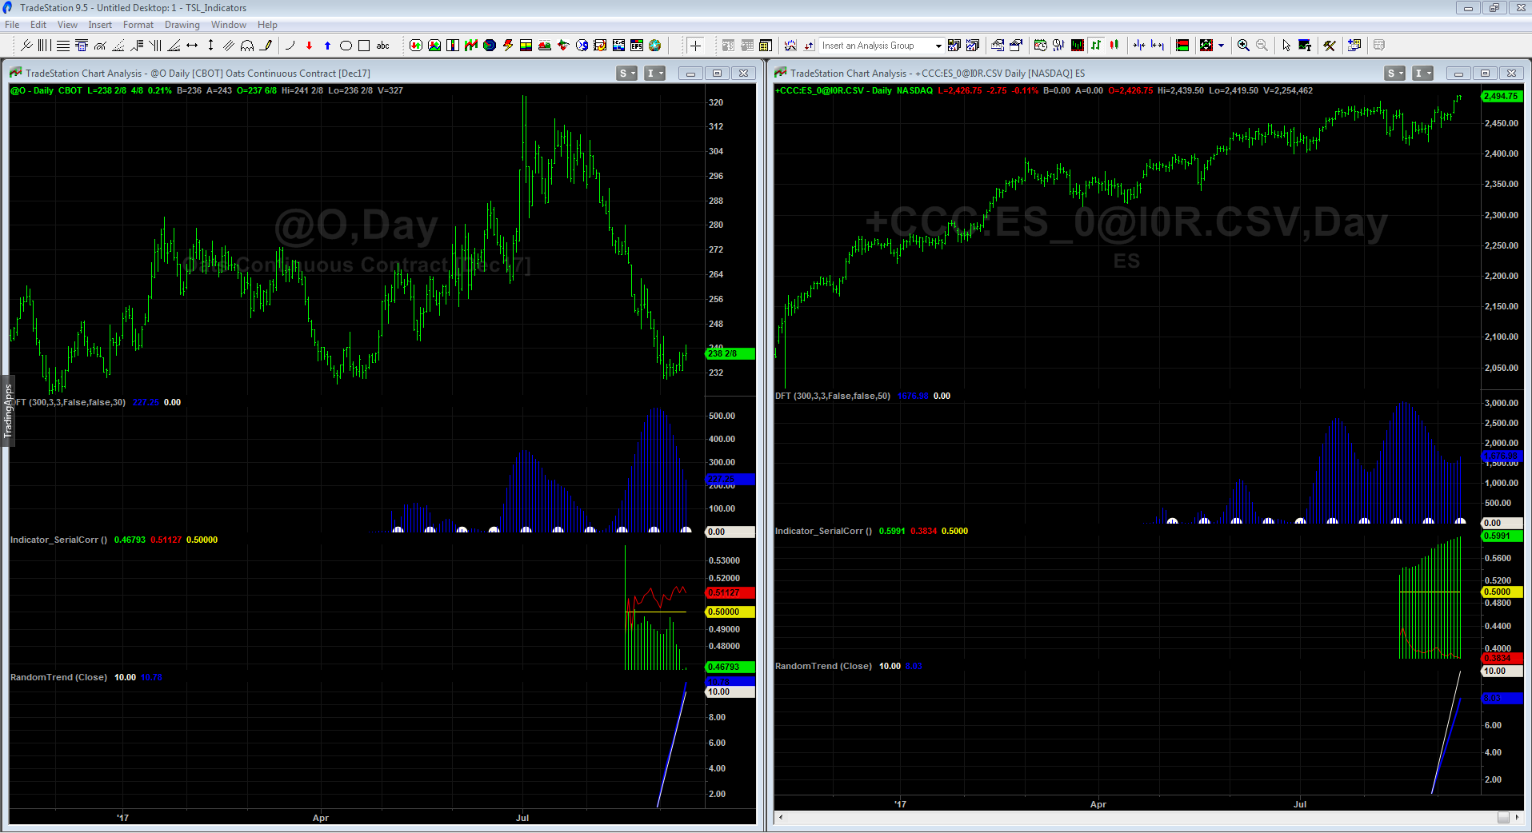
TSL DESCRIPTIVE STATISTICS
OATS
S&P

Slide 29
THEN WRITE CODE THAT EXPLOITS THAT MOVEMENT
Long and Short signals may be different
System may/may not be always in the market
System may shift between several regimes or be comprised of multiple systems
System may shut down if loss criteria are exceeded
System may shift between entry types (limit, stop, etc.)

Slide 30
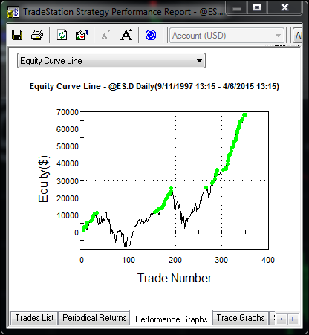
SAMPLE COUNTER-TRENDING TRADING SYSTEM
Weak Equity Curve

Slide 31
THINKSCRIPT HAS UNTAPPED CAPABILITY
This is an Entry Tactic.
TSL has 25 different
entry tactics. Several
are strategies of
strategies that co-evolve.

Slide 32
A BASIC EQUITY CURVE IN TOS

Slide 33
TSL CAN ML DESIGN STRATEGIES FOR TOS An Unlimited supply of unique strategies with NO programming

Slide 34
SPX NAKED OPTIONS AND CREDIT SPREADS BACKTEST
Uses a Trading system
on SPX then overlays
Options positions
Ref:AnOptionsDataBaseEnginePart2.pdf

Slide 35
OPTIONS BACKTESTING
Uses a Trading system
on SPX then overlays
Options positions
Ref:AnOptionsDataBaseEnginePart2.pdf

Slide 36
3 TOP REASONS WHY SYSTEMS FAIL
Use of too many parameters
Solution: Try to keep trade to parameter ratio
>= 100:1

Slide 37
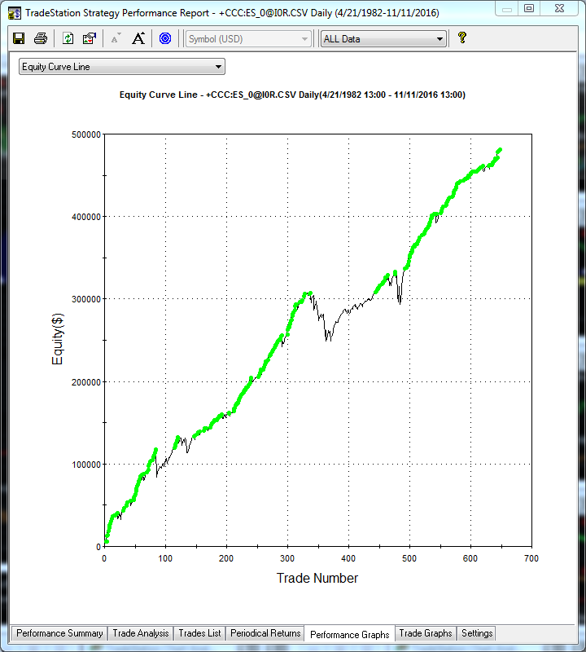
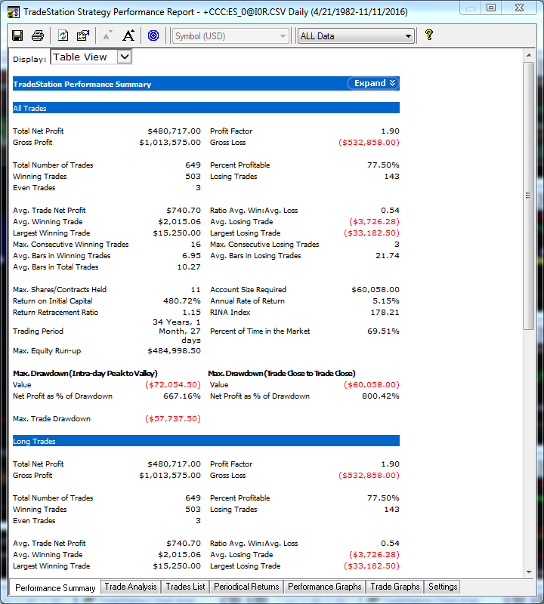
EXAMPLES Uses only one parameter.

Slide 38
3 TOP REASONS WHY SYSTEMS FAIL
2. Use of Insufficient amounts of data
Solution:
For daily data use 30 years of data if possible
For Intraday data: Depends on frequency and stability of descriptive stats

Slide 40
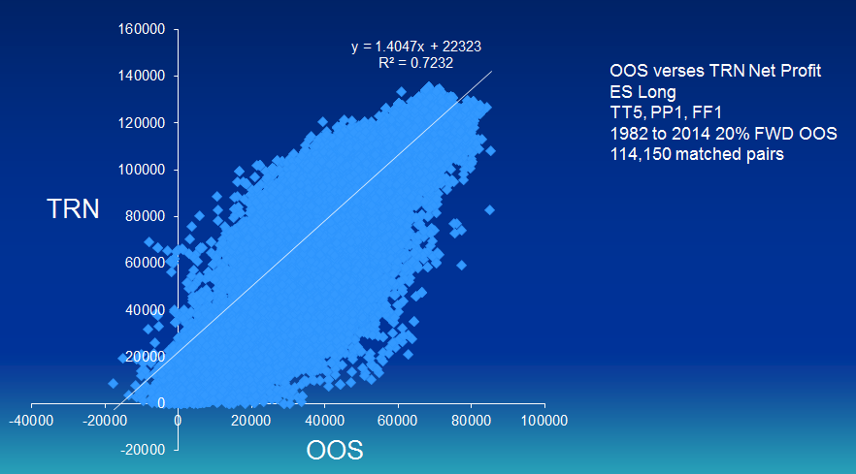
A DISTRIBUTION OF UNIQUE SYSTEMS FROM TSL
Systems are unique and novel. Evolves different systems for each user even with same setup due to Stochastic nature of process.

Slide 41
3 TOP REASONS WHY SYSTEMS FAIL
3. Not Using Out of Sample Data (OOS)
Solution:
Use both back and forward OOS for design
Then track system before trading it live

Slide 42
OOS, TRACK THEN TRADE Emini S&P
TRACK AND TRADE
OOS
IN SAMPLE
S&P Futures 1982-2017. Long only, TT5, PP1, FF4, GPex

Slide 43
THE TRADERS DILEMA Moving to ML designed Strategies
Same setups but yielding completely different results!
How do you solve this issue?
“Expectation of Trade”

Slide 44
WHICH SYSTEM WOULD YOU TRADE?
System 1:
35% accurate
Average Win is 180% of Average Loss
System 2:
90% accurate
Average Win is 10% of Average Loss

Slide 45
WHAT EQUATION PRODUCES ANY TRADING SYSTEM’S EXPECTATION?
EV = PW*AW – PL*AL
(1 equation and 3 unknowns since PW = 1-PL)
EV = expected value or average trade
PW = probability of a win
PL = probability of a loss
AW = amount won in winning trades
AL = amount lost in losing trades

Slide 46
FOR OUR 2 SYSTEMS:
System 1: EV = -.02
System 2: EV = -.01
So, neither System has a positive expectation!
Note:
* R-Squared may be very low in a good Trading System
A system that is 90% accurate can have a negative EV
A system that is 30% accurate can have a positive EV

Slide 47
WHAT IS A TSL ML DESIGNED TRADING SYSTEM?
Think of a System as an Object
That Object has Metrics
Invert a desired Metric and you have a Error
Ask the Machine to minimize that Error

Slide 48
WHAT IS A ML DESIGNED TRADING SYSTEM?
A Trading Strategy that has been designed by a AI Learning Machine and that is remarkably different from a strategy that a traditional human designer may create.
So the ML Algorithm must, sooner or later, solve the Expectation Problem

Slide 49
SOLVING EXPECTATION
To find solutions to the expectation equation, TSL connected a Trading Simulator to a
AI Learning Machine
Why not just try to predict the market using AI?

Slide 50
PREDICTION APPROACH
DATA
MODEL
PREDICTION
EXPECTATION
NOT GOOD ENOUGH?
IMPLEMENT
EXPECTATION APPROACH
EXPECTATION
DATA
IMPLEMENT
ML/AI MODEL
GOOD
ENOUGH?

Slide 51
WHAT IS THE BEST LEARNING ALGORITHM?
Supervised learning
AODE
Artificial neural network Backpropagation
Autoencoders
Hopfield networks
Boltzmann machines
Restricted Boltzmann Machines
Spiking neural networks
GE
GA
GP
LGP
LAIMGP *
GEP
CGP
GADS
IFGP
Bayesian statistics Naive Bayes classifier
Bayesian network
Bayesian knowledge base
Case-based reasoning
Decision trees
Inductive logic programming
Gaussian process regression
Gene expression programming
Group method of data handling (GMDH)
Learning Automata
Learning Vector Quantization
Logistic Model Tree
Minimum message length (decision trees, decision graphs, etc.)
Lazy learning
Instance-based learning Nearest Neighbor Algorithm
Analogical modeling
EM
OLS
KRR
PCA
Probably approximately correct learning (PAC)
Ripple down rules, a knowledge acquisition methodology
Symbolic machine learning algorithms
Subsymbolic machine learning algorithms
Support vector machines
Random Forests
Ensembles of classifiers Bootstrap aggregating (bagging)
Boosting (meta-algorithm)
Ordinal classification
Regression analysis
Information fuzzy networks (IFN)
Conditional Random Field
Statistical classification
ANOVA
Linear classifiers Fisher's linear discriminant
Logistic regression
Multinomial logistic regression
Naive Bayes classifier
Perceptron
Support vector machines
Quadratic classifiers
k-nearest neighbor
Boosting
Decision trees C4.5, CHIAD, CART
Random forests
Bayesian networks
Hidden Markov models
Unsupervised learning
Artificial neural network
Data clustering
Expectation-maximization algorithm
Self-organizing map
Radial basis function network
Vector Quantization
Generative topographic map
Information bottleneck method
IBSEAD
Association rule learning
Apriori algorithm
Eclat algorithm
FP-growth algorithm
Hierarchical clustering
Single-linkage clustering
Conceptual clustering
Partitional clustering
K-means algorithm
Fuzzy clustering
DBSCAN
Reinforcement learning
Temporal difference learning
Q-learning
Learning Automata
Monte Carlo Method
SARSA
Deep learning
Deep belief networks
Deep Boltzmann machines
Deep Convolutional neural networks
Deep Recurrent neural networks
Ref: http://en.wikipedia.org/wiki/Machine_learning

Slide 52
REGISTER GENETIC PROGRAMMING
Based loosely on biological models of evolution and eucaryotic* sexual reproduction
Simulates the path a biological species goes through as it evolves:
-Starts off simple
-Adapts to hostile environment
-Strong Parents give birth to strong children
-Random mutations may help
Works at the FAST CPU Register Level, not high level code
Fast, Accurate, and Writes Code
Different from GA and Tree Based GP
*Based on complex cells with membranes
Reference: http://www.tradingsystemlab.com/files/Discipulus%20How%20It%20Works.pdf

Slide 53
TSL LAIMGP LEARNING
Supervised Learning. No supervisory Signal.
Population is initialized
Trading Strategies are initialized with random signals
Tournament is run within population applied to the trading simulator
Mutation causes random changes in winners
Crossover exchanges DNA between winners
Reproduction is applied on remainder
Demes enhance genetic diversity
Parsimony Pressure favor simpler solutions
If n GWI occur then run restarts
New trading algorithms emerge and improve based on the error function
Algorithms learn to trade better as they trade in simulation
After x runs or user termination, all runs stop
Finally, code is exported, translated and ported to a Trading OMS/EMS

Slide 54
A TRADING SYSTEM SIMULATOR MAPS DATA TO EQUITY CURVES
Theoretically
Perfect
Equity Curve
MACHINE
DESIGNED SYSTEM
MAPPING
Profit
or
Loss
DATA
Time
The resultant equity stream net profit np[n] is given by:
$np[n]=\sum_{t=1}^{n}{\left( tp\left[t\right] \right)}$ + opp
The resultant net profit at t is given by:
$np[t]=np\left[t−1\right]+tp[t]$ + opp

Slide 55
TSL INPUT PREPROCESSING 10 Built In PP’s. Open Code-Fully customizable. 56 Inputs
Classical and Non-Classical Patterns
1, 2 and more bar patterns
Momemtum Patterns
Countertrend Patterns
Trend Patterns
Gaps and variations
Adaptive boolean patterns
Adaptive numeric pattern relationships
Support and Resistance, adaptations and variations
Detrended pattern effects and variations
Classical and Non-Classical Indicators
Normalized variables
Transforms
Standard Deviation and variations
Averages and variations
Volatility, Volatility Ratios and variations
Adaptive Channels
Regressions and variations
Oscillators and variations
Detrended prices, oscillators and variations
Other DNA:
Intermarket data
Fundamental data
COT
Cycles:MESA, MEM, etc.
Machine readable news
Social Media
Exogeneous Data
Order Book Bid/Ask & Size
Order Book Movement
Order Book Stats

Slide 56
LAIMGP REPRODUCTIVE CROSSOVER Homologous and Non-Homologous crossover
Trading
Algorithm
Trading System can vary its size during evolution
Reference: Frank D. Francone Licensiate Thesis (2009)

Slide 57
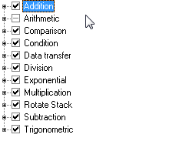
FUNCTION SETS: DNA More Function Sets allow deeper and wider ranges of solutions to be explored
TSL’s GP is 60-200 times faster than other Algorithms
TSL uses 34 Function Sets including +,-,*,/
http://www.tradingsystemlab.com/files/Discipulus%20How%20It%20Works.pdf

Slide 58
MACHINE EVOLVED AND WRITTEN CORE LOGIC OF YOUR TRADING SYSTEM
Translation Path:
Machine Code -> Core Logic C Code -> C#, EasyLanguage and others
long double f[8];
long double tmp = 0;
int cflag = 0;
f[0]=f[1]=f[2]=f[3]=f[4]=f[5]=f[6]=f[7]=0;
L0: f[0]-=v[25];
L1: f[0]+=v[43];
L2: f[0]=fabs(f[0]);
L3: f[0]-=v[13];
L4: f[0]-=v[49];
L5: f[0]-=v[41];
L6: f[0]*=f[0];
L7: f[1]-=f[0];
L8: f[0]+=v[22];
L9: tmp=f[1]; f[1]=f[0]; f[0]=tmp;
L10: cflag=(f[0] < f[2]);
L11: f[0]-=v[39];
if (!_finite(f[0])) f[0]=0;
return f[0];
C#, EL, PL, BLOX or
many other platforms
>>Note only 7 inputs are used here out of the
Initial 56 fact Terminal Set available

Slide 59
TSL MAIN COMPONENTS 9 Languages, > 1 million lines of code, 2 companies, 10+ years in development
EXCHANGE DATA EXOGENOUS DATA
CODE GENERATOR
Machine Code to C to C#, EL, etc.
LEARNING
MACHINE
TRADING SIM
OPTIONS SIM
CRR BTREE
BJERK-STENS
FITNESS EVALUATOR
RT PERFORMANCE
MACHINE DESIGNED
TRADING ALGORITHMS
EXCHANGE
OMS
EMS
DATA
ORDERS

Slide 60
WHAT IS TSL?
Automatically writes Trading Systems
No programming required
Any market, any time series, any bar type
Exports multiple languages
Devises its own patterns and indicators-or use your own
Overnight, Swing, Day-Trade, Pairs, Portfolios, Options
Anti-curve fit and pre-tested OOS “during” design
Patented and Trademarked: World Class Machine Learning
Beginner to PhD
#1 rated by Futures Truth on Sequestered Data
TradeStation, MultiCharts and other platforms compatible

Slide 61
OPTIONS ML DESIGN COMPLEXITY
In addition to determining when to get in and out of positions an ML based options strategy must:
Determine Strikes
Determine Days to Expiration
Determine options combinations
Take care of rollovers
Bid/Ask interpolation/extrapolation of data
Blend in Greeks into FF
Rolling adjustments (maintaining delta neutral)

Slide 62
SPEAKING OF GREEKS
First Second Third
Delta Gamma Color
Vega Vanna Speed
Theta Vomma Ultima
Rho Charm Zomma
Lamda Veta

Slide 63
SPEAKING OF GREEKS
A options based Fitness Function may be created that blends in a greek ratio with a Profit metric.
Example: FF = 1/(Sharpe*(Theta/Delta))
For a combination involving a Short Options Strategy

Slide 64
WHAT OPTIONS ALGORITHMS ARE IN TSL?
Cox-Ross-Rubenstein Binomial-Tree Model
Bjerksund-Stensland Options American Model

Slide 65
HOW DO I DESIGN A ML BASED OPTIONS STRATEGY IN TSL?
Select Underlying and Preprocess Data
Configure options criteria and Evolve System
Implement
Or
Evolve directional Strategy on underlying
Backtest evolved Strategy in Options Package
Implement

Slide 66
WHAT ARE TT, FF AND PP?
TT = TradeTypes (Limit, Market, Stop, etc.)
FF = Fitness Function(Net Profit, Sharpe, etc.)
PP = Preprocessor Type

Slide 67
OVER TRAINING NON-ROBUSTNESS

Slide 68
THE FAILURE OF BACKTESTS
Are not proof of Robustness
High Potential for Over-Fitting
False sense of returns
Reinforces bad design approaches
Like trying to find a needle in a haystack
WHAT CAN I DO ABOUT THIS ISSUE?
Sequestered Data (Tests conducted in the Future)
Out Of Sample Testing
Walk Forward Testing
Walk Backwards Testing
Differential Market Testing
Stress and Parametric Testing
Distribution and Matched Pairs Testing(Null)
Reference:” Pseudo-Mathematics and Financial Charlatanism:
The Effects of Backtest Overfitting on Out-of-Sample Performance, Marcos Lopez de Prado and 3 others.

Slide 69
ROBUSTNESS (Over Fit Avoidance)
Forward and Back OOS Testing (Walk either)
Run Path Logs (Path intelligence)
Unbiased Terminal Set (Directionless inputs)
Multi-Run, Randomized Criteria (Global optimum)
Zero Point Origin (No predefined initial point)
Parsimony Pressure (Occam’s razor)
Stat Tests-Distribution is exported (Reject Null)
TTPR, including subsystems (Degrees of Freedom)
Data duration and choice (More is better)
Post Design/Post OOS tests (Second Blind)
Sequestered Data Testing (Extreme testing)

Slide 70
EXAMPLES No Stops or Targets. You should add a large protective stop.

Slide 71
ROBO-ADVISING
VS
ROBO-ACTIVITY

Slide 72
WHICH ROBOT DO YOU PREFER?
Robo-Advising rebalances portfolios
and may be based on ML/AI mining of
underlying's performance
Evolved Robo-Advisors have both a portfolio
balancing element and a trading element

Slide 73
THE EVOLVED ADVISOR™
TSL can already do portfolio allocations with money management targeting a wealth metric objective.
Here, higher level GP outputs,
through simulations, decide
what current allocations should be so as to optimize Sharpe Ratio or any of over 40 objectives. Rebalancing
is user or GP controlled.
Since you can rebalance yourself down to zero in a downward market, this “Advisor” trades in and out of positions.

Slide 74
WE DID IT!
Submitted TSL systems to Futures Truth in 2008 and 2010
SP/ES, NG Systems machine designed in 2007 or earlier
No changes allowed after submission
FT holds the code and does their own testing
Designs are frozen and are held for 18+ months
Then Tested only on data that did not exist at the time of the design: e.g.: through the 2008-2010 financial collapse
Competition included over 700 market-models submitted
by 80+ worldwide developers/quants

Slide 75
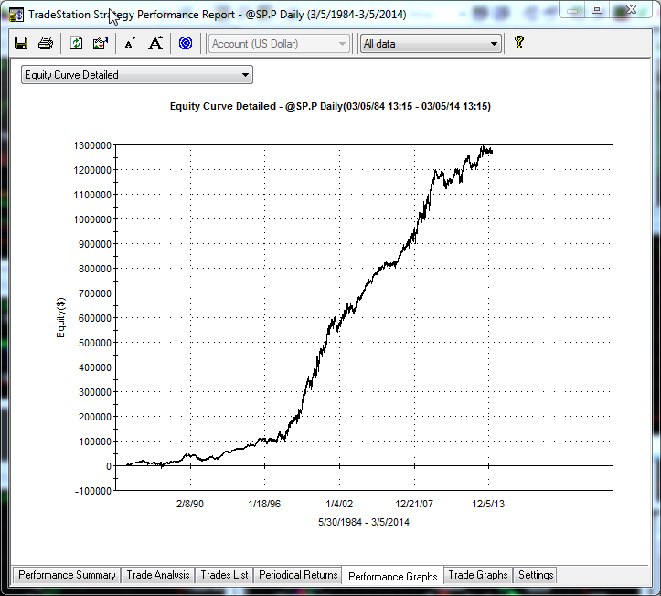
HOW IS THE SEQUESTERED DATA COMPETITION PERFORMED?
COMPETITION
PHASE
BEGINS:
DESIGN
FROZEN
2008
WORLD
FINANCIAL
DISASTER
OOS
DATA
OVERFIT
STRATEGY
WILL FAIL
TRAINING
DATA

Slide 76
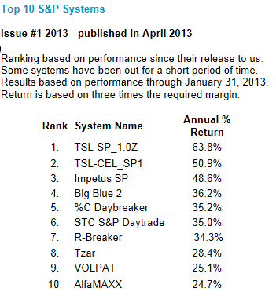
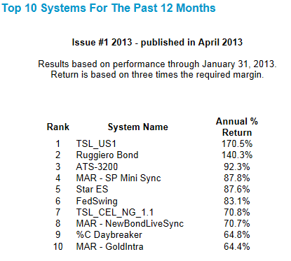
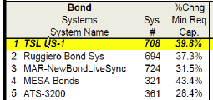
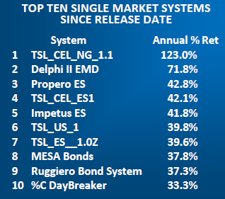
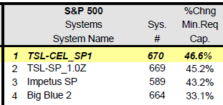
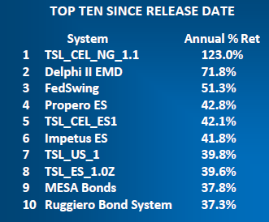
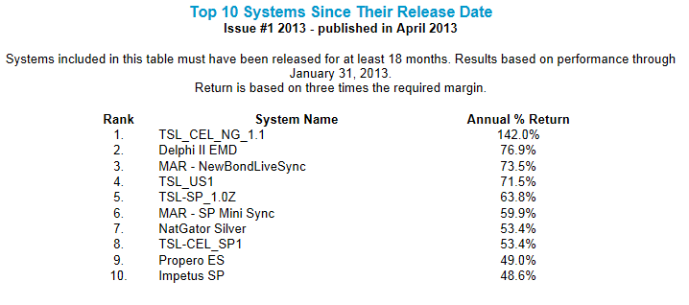
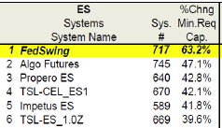
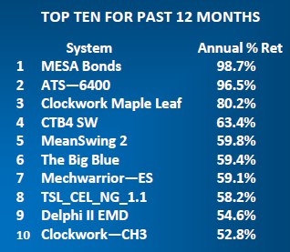
THE RESULTS? MACHINE CREATED IN 2007 or 2010 WITH NO PROGRAMMING REQUIRED
2014 Reports
TSL SP
on ES
700+ systems, 80+ vendors

Slide 77
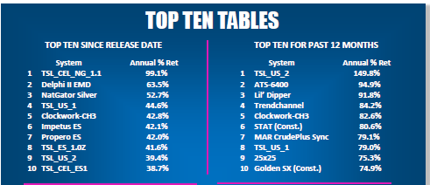
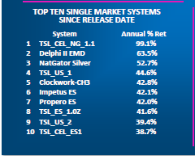
TSL MACHINE CREATED IN 2007 OR 2010 WITH NO PROGRAMMING REQUIRED
2015 Reports
TSL SP
on ES
700+ systems, 80+ developers
Reference: http://futurestruth.com/wpftruth/top-10-tables

Slide 78
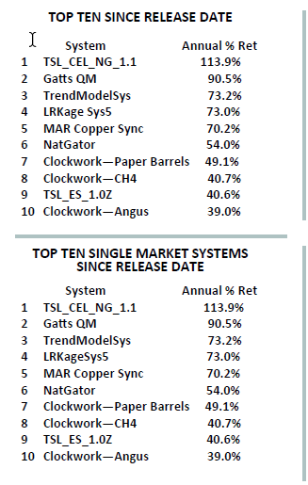
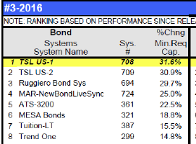
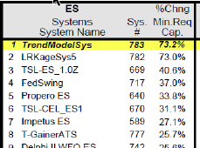
TSL MACHINE CREATED IN 2007 OR 2010 WITH NO PROGRAMMING REQUIRED
2016 Reports
TSL SP
on ES
700+ systems, 80+ developers
Reference: http://futurestruth.com/wpftruth/top-10-tables

Slide 79
TSL FUTURES TRUTH RATINGS SINCE CREATION IN 2007 (2010 US SYSTEMS) Highest Position any Category After 18 month initial Sequestered Period
YEAR | SP1.0z/ES1.0z | SP1/ES1 | US1 | US2 | NG1 | DX1
2009 | 2 | 3 |  |  | 1
2010 | 2 | 3 |  |  | 1
2011 | 1 | 2 |  |  | 1
2012 | 1 | 2 | 1 | 1 | 1 | 1
2013 | 1 | 2 | 1 | 3 | 1 | 8
2014 | 1 | 2 | 1 | 9 | 1 | 5
2015 | 1 | 4 | 1 | 2 | 1 | <10
2016 | 3 | 6 | 1 | 2 | 1 | <10
2017 | 5 | 6 | 3 | 5 | 4 | <10
S&P pit closed. Systems now applied to eMINI SP
Unfavorable Bias
Variance Tradeoff
(Retraining needed)
Note: 700+ systems and 80+ developer in competition

Slide 80
WHAT DOES THE SEQUESTERED DATA TESTS SHOW?
That the TSL Machine Designed Systems, un-reoptimized and un-altered, can perform well on data that did not exist at the time the systems were created; tested on future data, in the future.
That the systems can perform well in the future, through the most disruptive financial period of our lives. (2008-2010 financial disaster)
That an independent third party has no problem using the code and the systems for testing in their offices, on their computers, on their data and on their testing schedule.
Any argument that the blind data was inadvertently used by the development procedure is not applicable.

Slide 81
EVERYTHING IS A TRADEOFF
NET PROFIT
COMPLEXITY
SHARPE RATIO
UNDERFIT
TRADING SYSTEM
DESIGN
TRADEABILITY
UNDERWATER TIME
AVERAGE TRADE
PERCENT ACCURACY
MAR
PROFIT FACTOR
OVERFIT
DRAWDOWN
ROBUSTNESS
How do you deal with all of this? BACKTESTS?

Slide 82
ML DESIGN IN TSL Basic Approach
Pick Fitness Function and Trading Simulation criteria
Run, Design, Refine and Implement

Slide 83
ML DESIGN IN TSL Intermediate Approach
Begin EVORUN™
Choose best Configurations
Re-Run, Design, Refine and Implement

Slide 84
ML DESIGN IN TSL Advanced Approach
Begin a DAS™ run
Adjust and study in “Design Time”
Finalize and Implement

Slide 85
WHAT IS DAYTRADE DISCRETE BARS (DTDB)?
Offers an alternative DayTrade System
Enter and Exit on same bar (Limited TT’s)
Generally using Larger Bars
Can use lots of historical data but design fast
Use ID-DT System Stats Report:
Time of Day, Day of Week, Day Of Month
Month, Day of Week in Month

Slide 86
TRADING STRATEGY DESIGN IN 3 SIMPLE STEPS No Programming Required
Preprocess
Evolve
Translate

Slide 87
THE DO’S OF TRADING A SYSTEM
Do be adequately capitalized
Do understand the system drawdown
Do have an experienced broker trade it
Do give the system adequate time to work
Do use money you can afford to lose
Do trade the system the way it is intended

Slide 88
THE DONT’S OF SYSTEM TRADING
Don’t jump from system to system
Don’t quit at the first sign of a drawdown
Don’t pyramid at a run up in equity
Don’t miss any trades
Don’t try to outguess the system
Don’t alter the system parameters
Don’t use money you can’t afford to lose

Slide 89
BREAK TIME!

Slide 90
OPTIONS DESIGNS USING ML WE STUDIED 5 APPROACHES
1. Use TSL and options models (w/o IVOL) to choose strike price and entry and exit locations for fixed options combinations and Days to Expiration
Fast Design. High PF. Poor accuracy.

Slide 91
OPTIONS DESIGNS USING ML WE STUDIED 5 APPROACHES
2. Use TSL and options models (with IVOL) to choose strike price and entry and exit locations for fixed options combinations and Days to Expiration
Slower design. Still suffered accuracy issues. Not fully developed in favor of more accurate solutions.

Slide 92
OPTIONS DESIGNS USING ML WE STUDIED 5 APPROACHES
3. Use TSL to design trading strategies on underlying, then overlay options backtest in TradeStation using IVOLATILITY.COM options data lookup engine.
Implemented. Produced better quality results. Showed positions involving short options had higher PF.
Ref:http://www.tradingsystemlab.com/whitepaper.aspx

Slide 93
OPTIONS DESIGNS USING ML WE STUDIED 5 APPROACHES
4. Use TSL and full option data lookup high engine in automated design
Results: Data Hashing engine not fully integrated to TSL

Slide 94
OPTIONS DESIGNS USING ML WE STUDIED 5 APPROACHES
5. Use TSL to design strategies on underlying, then use dedicated options backtest (bid/ask) data engine to test designs.
Results: Implemented. Showed more reliable and accurate results using 10 year bid/ask options data base.

Slide 95
RICKS TSL BASED OPTIONS DESIGNS USING ML ML design on underlying, then overlay options bid/ask backtest
MARKET | TSL ML TYPE | OPT OVERLAY | PF OPTIONS | PF TSL | BUY/HOLD MKT PTS | TSL PTS | DD PTS BUY/HOLD | DD PTS TSL | % CORRECT TSL
SPY | LONG ONLY | NAKED PUT | 2.06 | 2.2 | 190 | 452 | 88 | 51 | 70.56
SPY | LONG ONLY | BEAR PUT | 1.83 | 2 | 190 | 452 | 88 | 51 | 70.56
IWM | LONG ONLY | NAKED PUT | 2.15 | 2.19 | 92 | 251 | 50 | 17 | 68.39

Slide 96
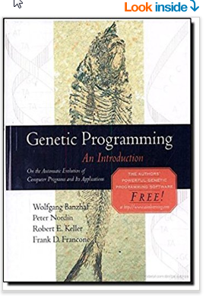
TSL’S TECH IS IN A BOOK Genetic Programming: An Introduction (The Morgan Kaufmann Series in Artificial Intelligence) 1st Edition by Wolfgang Banzhaf (Author), Peter Nordin (Author), Robert E. Keller (Author), Frank D. Francone (Author)

Slide 97
CONCLUSION
MACHINE LEARNING WILL CONTINUE TO BEAT
MANUAL DESIGNS!
www.tradingsystemlab.com
408-356-1800 voice or text
Check out the Kindle Book: Best Trading Strategies and
our section on Machine Designed Trading Strategies
Join our Silicon Valley Machine Learning for Trading Strategies MeetUp Group

