Slide 1
THE MACHINE OF THE FUTURE: TSL®, EVORUN™ AND DAS™
Presented to:
International Traders Expo
Las Vegas 2016

Slide 2
YOUR PRESENTER: MIKE BARNA, CTA
Founder and President, Trading System Lab
Co-Founder and Sr.VP Regency Stocks and Commodities Fund, LP,LLC, QEP, CPO, CTA
Series 3, Series 30, CTA
Public Systems Designed: R-MESA, BIGBLUE, MESA BONDS, MESA NOTES,
BS Mathematics, Arizona State University
MS Astronautical and Aeronautical Engineering, Stanford University
Former Defense Industry Rocket-Ramjet, Laser and Guidance Engineer
Lockheed, United Technologies, Hughes Aircraft
Star Wars Research and Development Management Engineer
13 FAA pilot certificates or ratings, CA DRE
Contact: www.tradingsystemlab.com mike@tradingsystemlab.com 408-356-1800

Slide 3
OUR DIVISION LEADERS
Mike Barna: Trading System Lab-Silicon Valley Based trading research and development company with a team of international and domestic programmers, third party developers and testers. Developed the First Commercially available Machine Designed Trading Systems Platform that requires no programming from the user.
www.tradingsystemlab.com
Frank Francone: Register Machine Learning, Inc.-US Based company with a team of international and domestic machine learning scientists, IP attorneys, statisticians and programmers. Involved in government contracts. Produces the LAIMGP licensed exclusively to TSL. Authored the leading University Textbook on GP. 1600 citations.
www.rmltech.com

Slide 4
TSL CLIENTS AND TRADERS TSL’s JOB IS TO PROVIDE TSL TO CLIENT TRADERS
Major Wall Street Investment Bank Trader >$100M
Small and Mid size CTA’s: $10M-$100M
Proprietary Trading Firms: $5M-$50M
Individual Traders < $5M
International Traders and Funds
Strategy Development Engineers
Beginner to PhD

Slide 5
REQUIRED DISCLAIMER
HYPOTHETICAL PERFORMANCE RESULTS HAVE MANY INHERENT LIMITATIONS, SOME OF WHICH ARE DESCRIBED BELOW. NO REPRESENTATION IS BEING MADE THAT ANY ACCOUNT WILL OR IS LIKELY TO ACHIEVE PROFITS OR LOSSES SIMILAR TO THOSE SHOWN.
IN FACT, THERE ARE FREQUENTLY SHARP DIFFERENCES BETWEEN HYPOTHETICAL PERFORMANCE RESULTS AND THE ACTUAL RESULTS ACHIEVED BY ANY PARTICULAR TRADING PROGRAM. ONE OF THE LIMITATIONS OF HYPOTHETICAL PERFORMANCE RESULTS IS THAT THEY ARE GENERALLY PREPARED WITH THE BENEFIT OF HINDSIGHT. IN ADDITION, HYPOTHETICAL TRADING DOES NOT INVOLVE FINANCIAL RISK, AND NO HYPOTHETICAL TRADING RECORD CAN COMPLETELY ACCOUNT FOR THE IMPACT OF FINANCIAL RISK IN ACTUAL TRADING. FOR EXAMPLE, THE ABILITY TO WITHSTAND LOSSES OR TO ADHERE TO A PARTICULAR TRADING PROGRAM IN SPITE OF TRADING LOSSES ARE MATERIAL POINTS WHICH CAN ALSO ADVERSELY AFFECT ACTUAL TRADING RESULTS.
THERE ARE NUMEROUS OTHER FACTORS RELATED TO THE MARKETS IN GENERAL OR TO THE IMPLEMENTATION OF ANY SPECIFIC TRADING PROGRAM WHICH CANNOT BE FULLY ACCOUNTED FOR IN THE PREPARATION OF HYPOTHETICAL PERFORMANCE RESULTS AND ALL OF WHICH CAN ADVERSELY AFFECT ACTUAL TRADING RESULTS.

Slide 6
EVERYTHING IS A TRADEOFF
NET PROFIT
COMPLEXITY
SHARPE RATIO
UNDERFIT
TRADING SYSTEM
DESIGN
TRADEABILITY
UNDERWATER TIME
AVERAGE TRADE
PERCENT ACCURACY
MAR
PROFIT FACTOR
OVERFIT
DRAWDOWN
ROBUSTNESS

Slide 7
ML DESIGN IN TSL Basic Approach
Pick Fitness Function and Trading Simulation criteria
Run, Design, Refine and Implement

Slide 8
ML DESIGN IN TSL Intermediate Approach
Begin EVORUN
Choose best Configurations
Re-Run, Design, Refine and Implement

Slide 9
WHAT IS EVORUN™?
EVORUN is a TSL multi run iterator:
Trade Type
Fitness Function
Preprocessor
Bar Size
Max Trades per Day

Slide 10
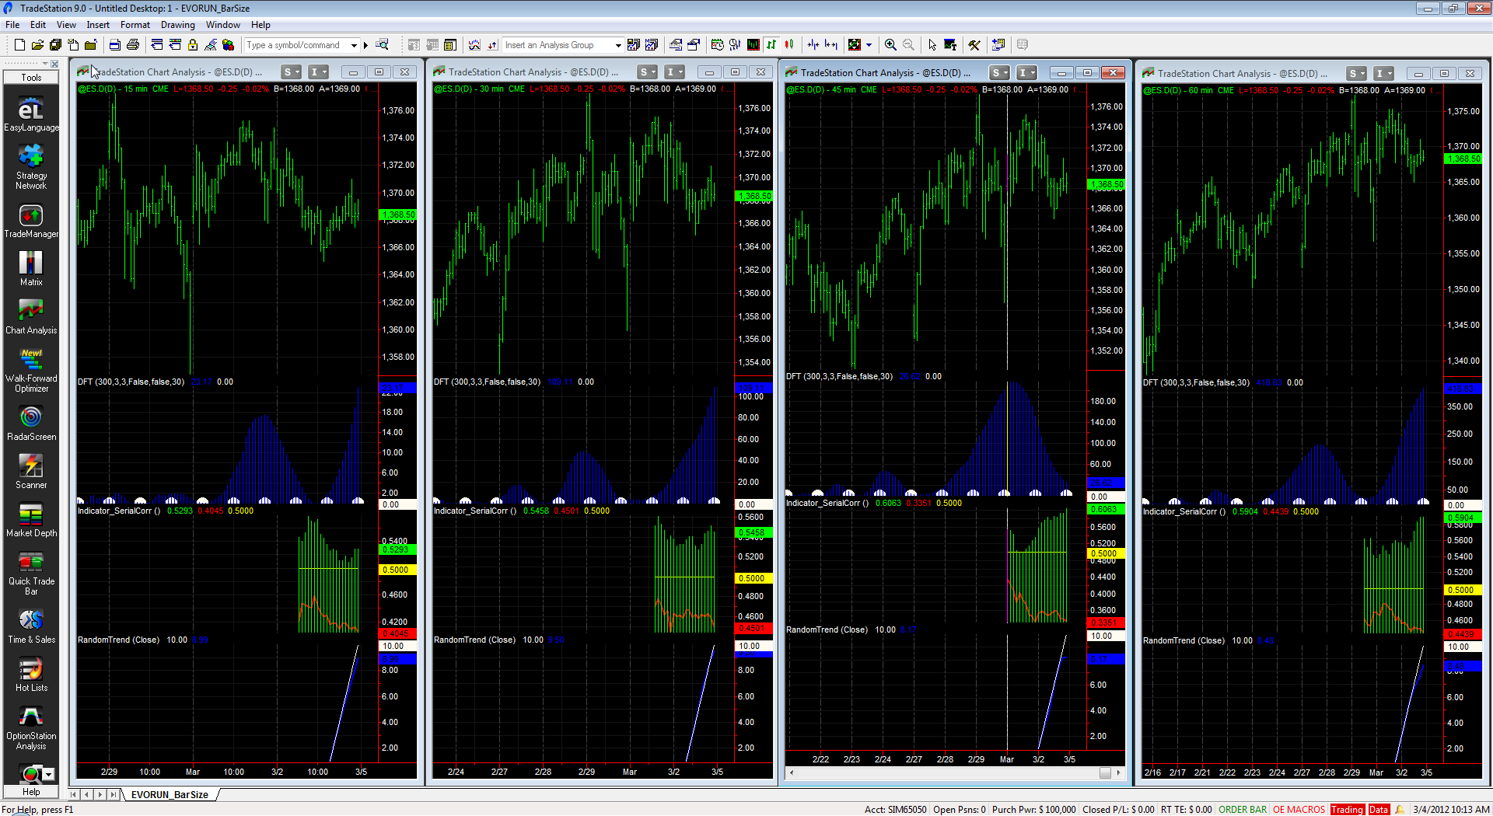
EVORUN™ WHAT IS THE BEST BAR SIZE?
ES 15 Min?
30 Min?
45 Min?
60 Min?

Slide 11
ML DESIGN IN TSL Advanced Approach
Begin a DAS™ run
Adjust and study in “Design Time”
Finalize and Implement

Slide 12
WHAT IS DAS™? Design-Time Adjustable Solutions
DAS™ is a Variable Design Time Engine
Allows altering of Simulation and Fitness objectives during design runs
Takes advantage of TSL’s Multi Run power
Allows nearly immediate evaluation of changes
Allows nearly immediate Design Time redesign without having to stop, reconfigure and rerun
Provides human feedback into design never before realized in Automatic Trading System Design

Slide 13
WHAT CAN I DO WITH DAS™? Switch criteria DURING RUN
Change Fitness and Simulation criteria in “Design Time” (While the Engine is Running)
Reduces the need for stopping, starting and rerunning the engine.
Reduces the need for EVORUN.
Allows EVORUN, or any other run for that matter to be redirected to look at a particular area of solutions during the run.

Slide 14
DAS ALLOWS DESIGN TIME EXPLORATION OF ALTERNATE REGIMES
Very Good Solutions
S2
TSL’s
Available
Solutions
S3
SOLUTION
REGIMES
S1
S4
Very Bad Solutions
S5
Other
Approaches

Slide 15
WHAT INTRA DESIGN TIME CRITERIA CAN I DAS-ADJUST?
% Accuracy Target
Profit Factor Target
Sharpe Ratio Target
MAR Target
Drawdown Target
Average Trade Target
Fitness Functions (41)
TradeTypes(25)
Preprocessors(5)
Long and/or Short
Back or Forward OOS
Stops-Fixed/%
GP evolved Stops
Exits-Fixed/%
GP evolved Exits
N bar exits
Money Management
Risk and Size
Constant Dollars
Forced Trading

Slide 16
WHAT IS DAYTRADE DISCRETE BARS (DTDB)?
Enter and Exit on same bar (Limited TT’s)
Generally using Larger Bars
Can use lots of historical data but design fast
Use ID-DT System Stats Report:
Time of Day, Day of Week, Day Of Month
Month, Day of Week in Month

Slide 17
ROBUSTNESS (Over Fit Avoidance)
Forward and Back OOS Testing (Walk either)
Run Path Logs (Path intelligence)
Unbiased Terminal Set (Directionless inputs)
Multi-Run, Randomized Criteria (Global optimum)
Zero Point Origin (No predefined initial point)
Parsimony Pressure (Occam’s razor)
Stat Tests-Distribution is exported (Reject Null)
TTPR, including subsystems (Degrees of Freedom)
Data duration and choice (More is better)
Post Design/Post OOS tests (Second Blind)
Sequestered Data Testing (Extreme testing)

Slide 18
TSL 2016 FEATURES
DAS:
Allows configuration changes “during” evolution run
Near Instant re-evaluations of configuration changes
Allows for Soft Targets to be re-adjusted “during run”
Reduces need to start, stop, restart run
POST DESIGN EVALUATIONS:
Allows for post-run evaluations of Best Programs in TSL
Aids in selection of final systems
SUPER BUFFER INCREASE:
Increases Best Programs size to max 300 available
systems per run

Slide 19
TSL 2016 FEATURES
DTDB:
Day-Trade Discrete Bars
Design will enter and exit on same bar
Simpler Day-Trade systems emerge
TT’s: NextOpen with GPE, Limit, NOPS
DAS and EVORUN compatible
SUB SYSTEM TRADE COUNT
Allows TTPR to be computed for each subsystem
Aids in robustness enhancement

Slide 20
TRADING STRATEGY DESIGN IN 3 SIMPLE STEPS No Programming Required
Preprocess
Evolve
Translate

Slide 21
CONCLUSION
MACHINE LEARNING WILL CONTINUE TO BEAT
MANUAL DESIGNS!
www.tradingsystemlab.com
408-356-1800 voice or text
Check out the Kindle Book: Best Trading Strategies and
our section on Machine Designed Trading Strategies
Join our Silicon Valley Machine Learning for Trading Strategies MeetUp Group

