Slide 1
HOW THE TSL MACHINE DESIGNED THE #1 TRADING STRATEGY
Presented to:
International Traders Expo
Las Vegas 2016

Slide 2
YOUR PRESENTER: MIKE BARNA, CTA
Founder and President, Trading System Lab
Co-Founder and Sr.VP Regency Stocks and Commodities Fund, LP,LLC, QEP, CPO, CTA
Series 3, Series 30, CTA
Public Systems Designed: R-MESA, BIGBLUE, MESA BONDS, MESA NOTES,
BS Mathematics, Arizona State University
MS Astronautical and Aeronautical Engineering, Stanford University
Former Defense Industry Rocket-Ramjet, Laser and Guidance Engineer
Lockheed, United Technologies, Hughes Aircraft
Star Wars Research and Development Management Engineer
13 FAA pilot certificates or ratings, CA DRE
Contact: www.tradingsystemlab.com mike@tradingsystemlab.com 408-356-1800

Slide 3
OUR DIVISION LEADERS
Mike Barna: Trading System Lab-Silicon Valley Based trading research and development company with a team of international and domestic programmers, third party developers and testers. Developed the First Commercially available Machine Designed Trading Systems Platform that requires no programming from the user.
www.tradingsystemlab.com
Frank Francone: Register Machine Learning, Inc.-US Based company with a team of international and domestic machine learning scientists, IP attorneys, statisticians and programmers. Involved in government contracts. Produces the LAIMGP licensed exclusively to TSL. Authored the leading University Textbook on GP. 1600 citations.
www.rmltech.com

Slide 4
TSL CLIENTS AND TRADERS TSL’s JOB IS TO PROVIDE TSL TO CLIENT TRADERS
Major Wall Street Investment Bank Trader >$100M
Small and Mid size CTA’s: $10M-$100M
Proprietary Trading Firms: $5M-$50M
Individual Traders < $5M
International Traders and Funds
Strategy Development Engineers
Beginner to PhD

Slide 5
REQUIRED DISCLAIMER
HYPOTHETICAL PERFORMANCE RESULTS HAVE MANY INHERENT LIMITATIONS, SOME OF WHICH ARE DESCRIBED BELOW. NO REPRESENTATION IS BEING MADE THAT ANY ACCOUNT WILL OR IS LIKELY TO ACHIEVE PROFITS OR LOSSES SIMILAR TO THOSE SHOWN.
IN FACT, THERE ARE FREQUENTLY SHARP DIFFERENCES BETWEEN HYPOTHETICAL PERFORMANCE RESULTS AND THE ACTUAL RESULTS ACHIEVED BY ANY PARTICULAR TRADING PROGRAM. ONE OF THE LIMITATIONS OF HYPOTHETICAL PERFORMANCE RESULTS IS THAT THEY ARE GENERALLY PREPARED WITH THE BENEFIT OF HINDSIGHT. IN ADDITION, HYPOTHETICAL TRADING DOES NOT INVOLVE FINANCIAL RISK, AND NO HYPOTHETICAL TRADING RECORD CAN COMPLETELY ACCOUNT FOR THE IMPACT OF FINANCIAL RISK IN ACTUAL TRADING. FOR EXAMPLE, THE ABILITY TO WITHSTAND LOSSES OR TO ADHERE TO A PARTICULAR TRADING PROGRAM IN SPITE OF TRADING LOSSES ARE MATERIAL POINTS WHICH CAN ALSO ADVERSELY AFFECT ACTUAL TRADING RESULTS.
THERE ARE NUMEROUS OTHER FACTORS RELATED TO THE MARKETS IN GENERAL OR TO THE IMPLEMENTATION OF ANY SPECIFIC TRADING PROGRAM WHICH CANNOT BE FULLY ACCOUNTED FOR IN THE PREPARATION OF HYPOTHETICAL PERFORMANCE RESULTS AND ALL OF WHICH CAN ADVERSELY AFFECT ACTUAL TRADING RESULTS.

Slide 6
QUESTION 1:
What do Microsoft, Google, Facebook, IBM, Amazon and Apple have in common?

Slide 7
QUESTION 1:
What do Microsoft, Google, Facebook, IBM, Amazon and Apple have in common?
They are all investing in AI.

Slide 8
QUESTION 2:
If you do not have a statistically sound, mechanical
trading system, designed by AI or human, then
what do you have?

Slide 9
QUESTION 2:
If you do not have a statistically sound, mechanical
trading system, designed by AI or human, then
what do you have?
You have a guess
However, the allocators are not guessing

Slide 10
SYSTEMATIC VERSES DISCRETIONARY CTA MUM, $B 1999 to 2016
Systematic
(At least 95% Systematic)
Discretionary
(At least 65% Discretionary or Judgmental)

Slide 11
SYSTEMATIC VERSES DISCRETIONARY CTA

Slide 12
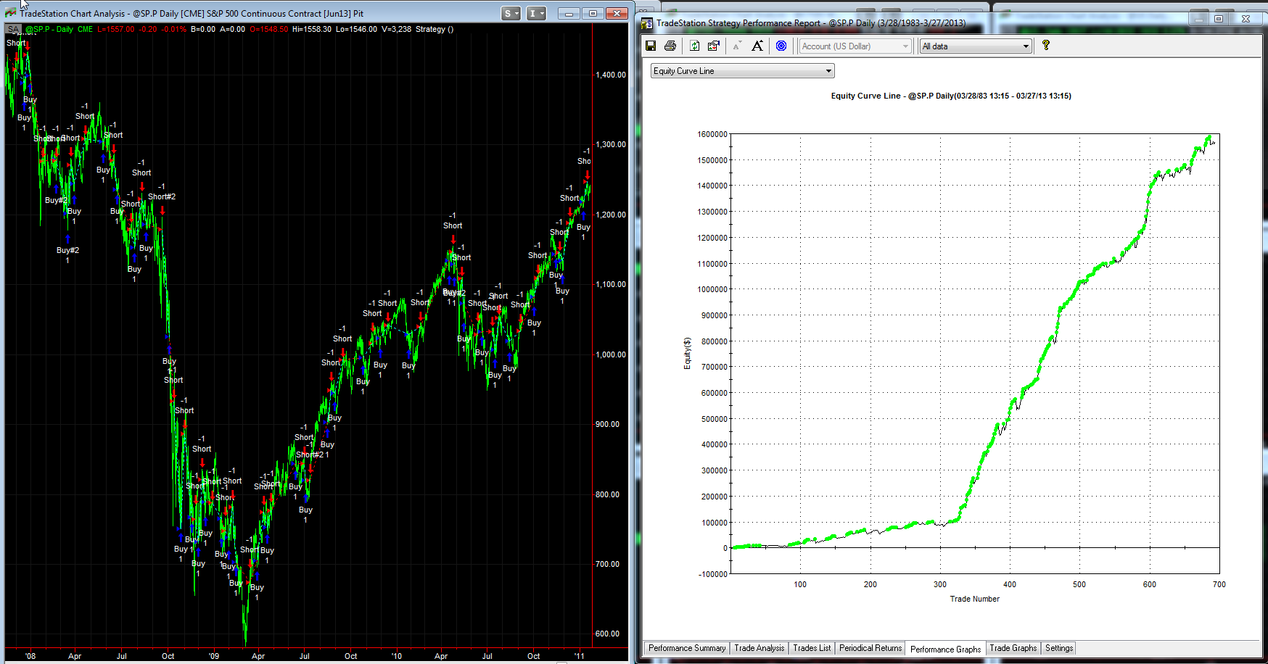
WHAT IS A TRADING SYSTEM EQUITY CURVE?
Release Date
MACHINE PRODUCED OR HUMAN DESIGNED
<ALGORITHMS>
1996 knee
S&P Futures 1982-2013

Slide 13
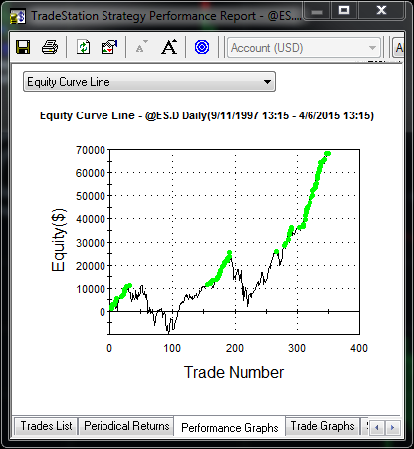
SAMPLE COUNTERTRENDING TRADING SYSTEM
Weak Equity Curve

Slide 14
THE TRADERS DILEMA:
Same setups but yielding completely different results!
How do you solve this issue?
“Expectation of Trade”

Slide 15
WHICH SYSTEM WOULD YOU TRADE?
System 1:
35% accurate
Average Win is 180% of Average Loss
System 2:
90% accurate
Average Win is 10% of Average Loss

Slide 16
WHAT EQUATION PRODUCES ANY TRADING SYSTEM’S EXPECTATION?
EV = PW*AW – PL*AL
(1 equation and 3 unknowns since PW = 1-PL)
EV = expected value or average trade
PW = probability of a win
PL = probability of a loss
AW = amount won in winning trades
AL = amount lost in losing trades

Slide 17
FOR OUR 2 SYSTEMS:
System 1: EV = -.02
System 2: EV = -.01
So, neither System has a positive expectation!
Note:
* R-Squared may be very low in a good Trading System
A system that is 90% accurate can have a negative EV
A system that is 30% accurate can have a positive EV

Slide 18
SOLVING EXPECTATION
To find solutions to the expectation equation, TSL connected a Trading Simulator to a
AI Learning Machine
Why not just try to predict the market using AI?

Slide 19
PREDICTION APPROACH
DATA
MODEL
PREDICTION
EXPECTATION
NOT GOOD ENOUGH?
IMPLEMENT
EXPECTATION APPROACH
EXPECTATION
DATA
IMPLEMENT
MODEL
GOOD
ENOUGH?

Slide 20
WHAT IS THE BEST LEARNING ALGORITHM?
Supervised learning
AODE
Artificial neural network Backpropagation
Autoencoders
Hopfield networks
Boltzmann machines
Restricted Boltzmann Machines
Spiking neural networks
GE
GA
GP
LGP
LAIMGP *
GEP
CGP
GADS
IFGP
Bayesian statistics Naive Bayes classifier
Bayesian network
Bayesian knowledge base
Case-based reasoning
Decision trees
Inductive logic programming
Gaussian process regression
Gene expression programming
Group method of data handling (GMDH)
Learning Automata
Learning Vector Quantization
Logistic Model Tree
Minimum message length (decision trees, decision graphs, etc.)
Lazy learning
Instance-based learning Nearest Neighbor Algorithm
Analogical modeling
EM
OLS
KRR
PCA
Probably approximately correct learning (PAC)
Ripple down rules, a knowledge acquisition methodology
Symbolic machine learning algorithms
Subsymbolic machine learning algorithms
Support vector machines
Random Forests
Ensembles of classifiers Bootstrap aggregating (bagging)
Boosting (meta-algorithm)
Ordinal classification
Regression analysis
Information fuzzy networks (IFN)
Conditional Random Field
Statistical classification
ANOVA
Linear classifiers Fisher's linear discriminant
Logistic regression
Multinomial logistic regression
Naive Bayes classifier
Perceptron
Support vector machines
Quadratic classifiers
k-nearest neighbor
Boosting
Decision trees C4.5, CHIAD, CART
Random forests
Bayesian networks
Hidden Markov models
Unsupervised learning
Artificial neural network
Data clustering
Expectation-maximization algorithm
Self-organizing map
Radial basis function network
Vector Quantization
Generative topographic map
Information bottleneck method
IBSEAD
Association rule learning
Apriori algorithm
Eclat algorithm
FP-growth algorithm
Hierarchical clustering
Single-linkage clustering
Conceptual clustering
Partitional clustering
K-means algorithm
Fuzzy clustering
DBSCAN
Reinforcement learning
Temporal difference learning
Q-learning
Learning Automata
Monte Carlo Method
SARSA
Deep learning
Deep belief networks
Deep Boltzmann machines
Deep Convolutional neural networks
Deep Recurrent neural networks
Ref: http://en.wikipedia.org/wiki/Machine_learning

Slide 21
A TRADING SYSTEM SIMULATOR MAPS DATA TO EQUITY CURVES
Theoretically
Perfect
Equity Curve
MACHINE
DESIGNED SYSTEM
MAPPING
Profit
or
Loss
DATA
Time
The resultant equity stream net profit np[n] is given by:
$np[n]=\sum_{t=1}^{n}{\left( tp\left[t\right] \right)}$ + opp
The resultant net profit at t is given by:
$np[t]=np\left[t−1\right]+tp[t]$ + opp

Slide 22
TSL INPUT PREPROCESSING 10 Built In PP’s. Open Code-Fully customizable. 56 Inputs
Classical and Non-Classical Patterns
1, 2 and more bar patterns
Momemtum Patterns
Countertrend Patterns
Trend Patterns
Gaps and variations
Adaptive boolean patterns
Adaptive numeric pattern relationships
Support and Resistance, adaptations and variations
Detrended pattern effects and variations
Classical and Non-Classical Indicators
Normalized variables
Transforms
Standard Deviation and variations
Averages and variations
Volatility, Volatility Ratios and variations
Adaptive Channels
Regressions and variations
Oscillators and variations
Detrended prices, oscillators and variations
Other DNA:
Intermarket data
Fundamental data
COT
Cycles:MESA, MEM, etc.
Machine readable news
Social Media
Exogeneous Data
Order Book Bid/Ask & Size
Order Book Movement
Order Book Stats

Slide 23
LAIMGP REPRODUCTIVE CROSSOVER Homologous and Non-Homologous crossover
Trading
Algorithm
Trading System can vary its size during evolution
Reference: Frank D. Francone Licensiate Thesis (2009)

Slide 24
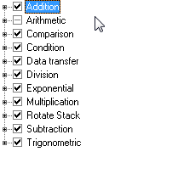
FUNCTION SETS: DNA More Function Sets allow deeper and wider ranges of solutions to be explored
TSL’s GP is 60-200 times faster than other Algorithms
TSL uses 34 Function Sets including +,-,*,/
http://www.tradingsystemlab.com/files/Discipulus%20How%20It%20Works.pdf

Slide 25
MACHINE EVOLVED AND WRITTEN CORE LOGIC OF YOUR TRADING SYSTEM
Translation Path:
Machine Code -> Core Logic C Code -> C#, EasyLanguage and others
long double f[8];
long double tmp = 0;
int cflag = 0;
f[0]=f[1]=f[2]=f[3]=f[4]=f[5]=f[6]=f[7]=0;
L0: f[0]-=v[25];
L1: f[0]+=v[43];
L2: f[0]=fabs(f[0]);
L3: f[0]-=v[13];
L4: f[0]-=v[49];
L5: f[0]-=v[41];
L6: f[0]*=f[0];
L7: f[1]-=f[0];
L8: f[0]+=v[22];
L9: tmp=f[1]; f[1]=f[0]; f[0]=tmp;
L10: cflag=(f[0] < f[2]);
L11: f[0]-=v[39];
if (!_finite(f[0])) f[0]=0;
return f[0];
C#, EL, PL, BLOX or
many other platforms
>>Note only 7 inputs are used here out of the
Initial 56 fact Terminal Set available

Slide 26
THE ARCHITECTURE
Real Time
or
Static Data
Machine
Readable
News
Market
Stack data
Slow
Pre-
Processing
Translators
Fast
Fitness
Out of Sample
Fastest*
GP Engine
Trading Engine
GUI
Full Data
High Level Code**
Low Level Code***
Dynamic
Static
Trading System Code
(C#, C++,
JAVA, EL)
EMS
OMS
RPT
ADM
*GPU/G80, EP or Many Core Implementations
**VC++.NET, VB, C#, EL
***Assembler, C, C++

Slide 27
WHAT IS TSL?
Automatically writes Trading Systems
No programming required
Any market, any time series, any bar type
Exports multiple languages
Devises its own patterns and indicators-or use your own
Overnight, Swing, Day-Trade, Pairs, Portfolios, Options
Anti-curve fit and pre-tested OOS “during” design
Patented and Trademarked: World Class Machine Learning
Beginner to PhD
#1 rated by Futures Truth on Sequestered Data
TradeStation, MultiCharts and other platforms compatible

Slide 28
OVER TRAINING NON-ROBUSTNESS

Slide 29
ROBUSTNESS (Over Fit Avoidance)
Forward and Back OOS Testing (Walk either)
Run Path Logs (Path intelligence)
Unbiased Terminal Set (Directionless inputs)
Multi-Run, Randomized Criteria (Global optimum)
Zero Point Origin (No predefined initial point)
Parsimony Pressure (Occam’s razor)
Stat Tests-Distribution is exported (Reject Null)
TTPR, including subsystems (Degrees of Freedom)
Data duration and choice (More is better)
Post Design/Post OOS tests (Second Blind)
Sequestered Data Testing (Extreme testing)

Slide 30
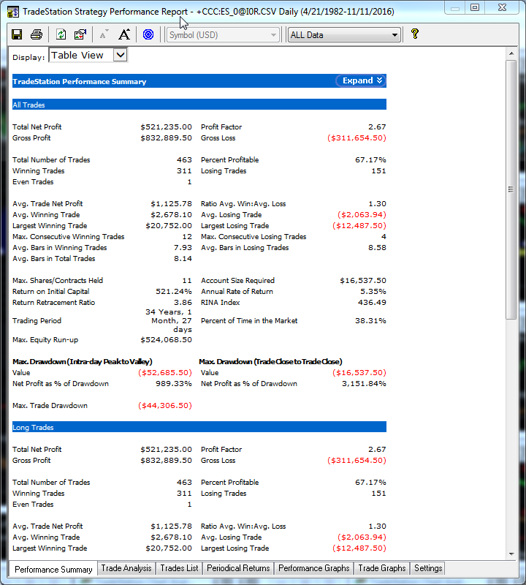
EXAMPLES No Stops or Targets. You should add a large protective stop.

Slide 31
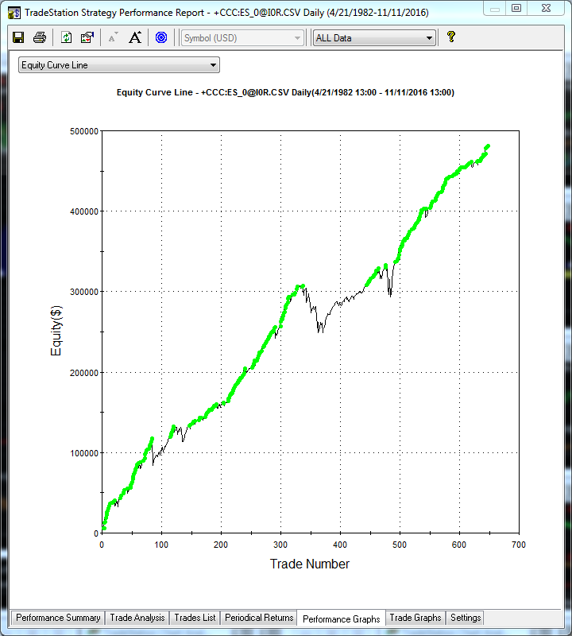
EXAMPLES Uses only one parameter.

Slide 32
WE DID IT!
Submitted TSL systems to Futures Truth in 2008 and 2010
SP/ES, NG Systems machine designed in 2007 or earlier
No changes allowed after submission
FT holds the code and does their own testing
Designs are frozen and are held for 18+ months
Then Tested only on data that did not exist at the time of the design: e.g.: through the 2008-2010 financial collapse
Competition included over 700 market-models submitted
by 80+ worldwide developers/quants

Slide 33
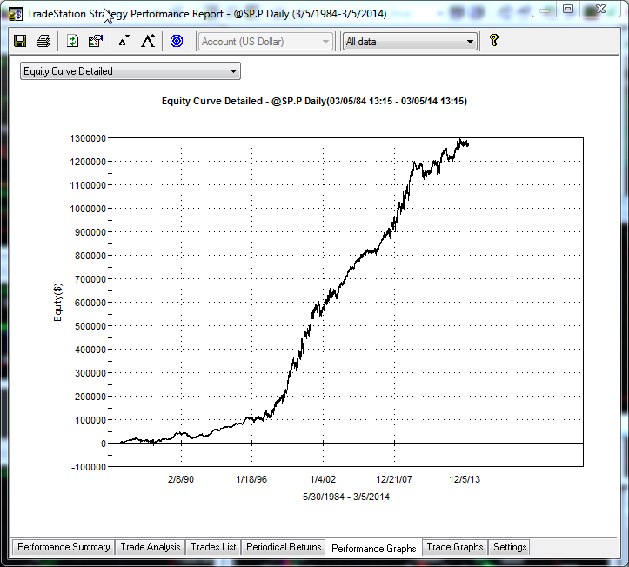
HOW IS THE SEQUESTERED DATA COMPETITION PERFORMED?
COMPETITION
PHASE
BEGINS:
DESIGN
FROZEN
2008
WORLD
FINANCIAL
DISASTER
OOS
DATA
OVERFIT
STRATEGY
WILL FAIL
TRAINING
DATA

Slide 34
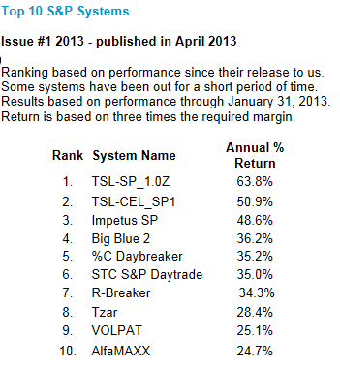
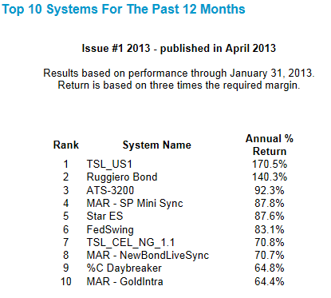
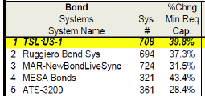
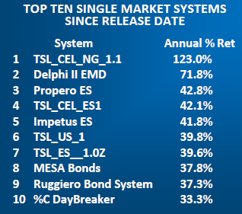
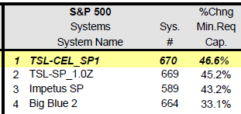
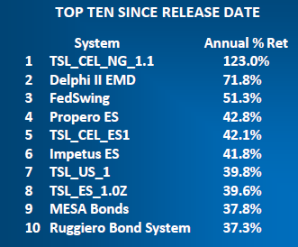
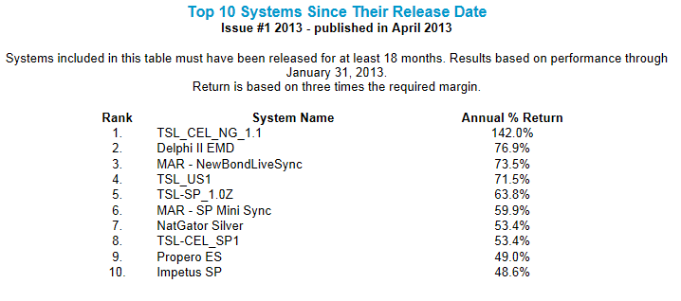
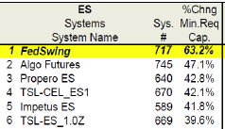
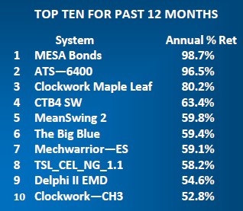
THE RESULTS? MACHINE CREATED IN 2007 or 2010 WITH NO PROGRAMMING REQUIRED
2014 Reports
TSL SP
on ES
700+ systems, 80+ vendors

Slide 35
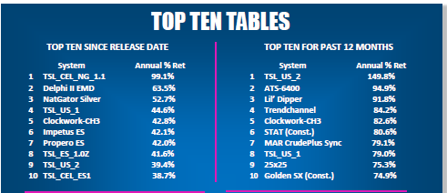
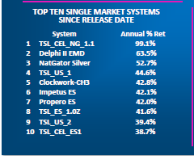
TSL MACHINE CREATED IN 2007 OR 2010 WITH NO PROGRAMMING REQUIRED
2015 Reports
TSL SP
on ES
700+ systems, 80+ developers
Reference: http://futurestruth.com/wpftruth/top-10-tables

Slide 36
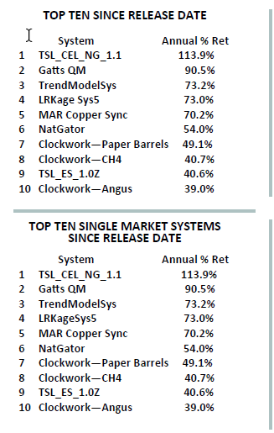
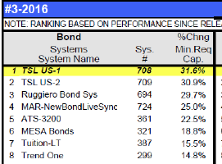
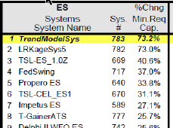
TSL MACHINE CREATED IN 2007 OR 2010 WITH NO PROGRAMMING REQUIRED
2016 Reports
TSL SP
on ES
700+ systems, 80+ developers
Reference: http://futurestruth.com/wpftruth/top-10-tables

Slide 37
TSL FUTURES TRUTH RATINGS OVER TIME Highest Position any Category After 18 month initial Sequestered Period
S&P pit closed. Systems now applied to eMINI SP
Unfavorable Bias
Variance Tradeoff
(Retraining needed)
Note: 700+ systems and 80+ developer in competition

Slide 38
WHAT DOES THE SEQUESTERED DATA TESTS SHOW?
That the TSL Machine Designed Systems, un-reoptimized and un-altered, can perform well on data that did not exist at the time the systems were created; tested on future data, in the future.
That the systems can perform well in the future, through the most disruptive financial period of our lives. (2008-2010 financial disaster)
That an independent third party has no problem using the code and the systems for testing in their offices, on their computers, on their data and on their testing schedule.
Any argument that the blind data was inadvertently used by the development procedure is not applicable.

Slide 39
EVERYTHING IS A TRADEOFF
NET PROFIT
COMPLEXITY
SHARPE RATIO
UNDERFIT
TRADING SYSTEM
DESIGN
TRADEABILITY
UNDERWATER TIME
AVERAGE TRADE
PERCENT ACCURACY
MAR
PROFIT FACTOR
OVERFIT
DRAWDOWN
ROBUSTNESS
How do you deal with all of this? BACKTESTS?

Slide 40
THE FAILURE OF BACKTESTS
Are not proof of Robustness
High Potential for Over-Fitting
False sense of returns
Reinforces bad design approaches
Like trying to find a needle in a haystack
WHAT CAN I DO ABOUT THIS ISSUE?
Sequestered Data (Tests conducted in the Future)
Out Of Sample Testing
Walk Forward Testing
Walk Backwards Testing
Differential Market Testing
Stress and Parametric Testing
Distribution and Matched Pairs Testing(Null)
Reference:” Pseudo-Mathematics and Financial Charlatanism:
The Effects of Backtest Overfitting on Out-of-Sample Performance, Marcos Lopez de Prado and 3 others.

Slide 41
ML DESIGN IN TSL Basic Approach
Pick Fitness Function and Trading Simulation criteria
Run, Design, Refine and Implement

Slide 42
ML DESIGN IN TSL Intermediate Approach
Begin EVORUN
Choose best Configurations
Re-Run, Design, Refine and Implement

Slide 43
ML DESIGN IN TSL Advanced Approach
Begin a DAS™ run
Adjust and study in “Design Time”
Finalize and Implement

Slide 44
WHAT IS DAYTRADE DISCRETE BARS (DTDB)?
Offers an alternative DayTrade System
Enter and Exit on same bar (Limited TT’s)
Generally using Larger Bars
Can use lots of historical data but design fast
Use ID-DT System Stats Report:
Time of Day, Day of Week, Day Of Month
Month, Day of Week in Month

Slide 45
TRADING STRATEGY DESIGN IN 3 SIMPLE STEPS No Programming Required
Preprocess
Evolve
Translate

Slide 46
CONCLUSION
MACHINE LEARNING WILL CONTINUE TO BEAT
MANUAL DESIGNS!
www.tradingsystemlab.com
408-356-1800 voice or text
Check out the Kindle Book: Best Trading Strategies and
our section on Machine Designed Trading Strategies
Join our Silicon Valley Machine Learning for Trading Strategies MeetUp Group

