Slide 1
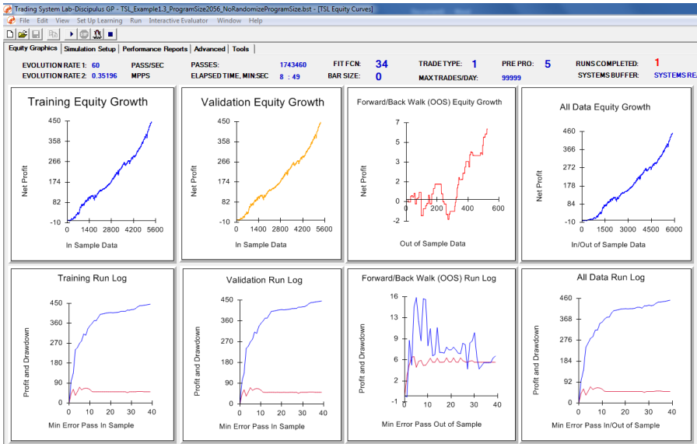
Machine Designed Trading System with Options Back-Test By Richard Alvarado, CFA
Part I: System Generation in TSL
The purpose of this paper is to show how a TSL user can build systems within TSL, then use the generated buy and sell signals to back-test how the strategy would have performed if the system traded options on the underlying instrument.
A long only system is first built within TSL using the ticker SPY. In a little over eight minutes, and having TSL sift through over 1,700,000 system combinations, my final systems is evolved with an equity curve and statistical characteristics I consider satisfactory.

Slide 2
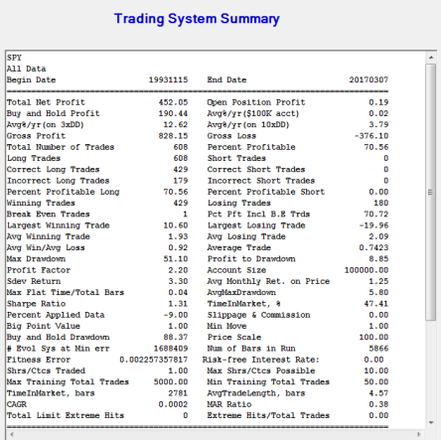
Part I: System Generation in TSL
In the below screenshot, you can see the TSL designed long only system trades roughly 608 times from 1993-2017, a profit factor of 2.20, and has a winning percentage of 70.56%.
Furthermore, over the back-test period roughly 452 SPY points of profit were generated, while a simple buy-and-hold approach would have generated roughly 190 SPY points of profit.
What must also be noted is the TSL designed system had a maximum drawdown of 51 SPY points, versus 88 for the simple buy-and-hold approach. Thus, TSL delivered superior risk adjusted returns.
The system was built within TSL using PP5 (PP=PreProcessor) and TT1 (TT=Trade Type). I will be testing the SPY signals on SPX Index Options, which I believe are a good fit considering the extremely high correlation between SPY and the SPX Index. TT1 (Trade at the close) was chosen because Key2Options uses closing prices when back-testing options.
Since SPY ceases trading at the close of the NYSE (4:00 PM EST), and SPX options cease trading at 4:15 PM EST, there is theoretically a 15-minute window where the TSL designed system can be run in a trading platform, and trade the appropriate option contract in real-time, giving the trader a 15-minute window to execute their trade.

Slide 3
Part II: Key2Options
The user must first import the buy and sell signals from TSL into the Key2Options platform.
Creating entry and exit dates are necessary for the Key2Options platform to understand exactly what dates option positions are being bought or sold. Key2Options has historical option data on hundreds of stocks and indices beginning in January of 2007, so roughly 10 years of historical option prices as of this time of publication are being used for any back-test.
Trade Rules must then be created within the Key2Options platform in order to instruct the algorithm to back-test a specific strategy. For example, in the screenshot below I create trade rules which short a Naked Put when a long signal is generated by the system I created within TSL.
I believe it is important to use actual bid and ask prices when back-testing. As can be seen in the screenshot below, the box to the right allows the user to either use “Mid-Price” or “Market” prices. I use the latter, as “Market” prices will sell at the bid and buy the ask, which is what a user would be doing in real time.

Slide 4
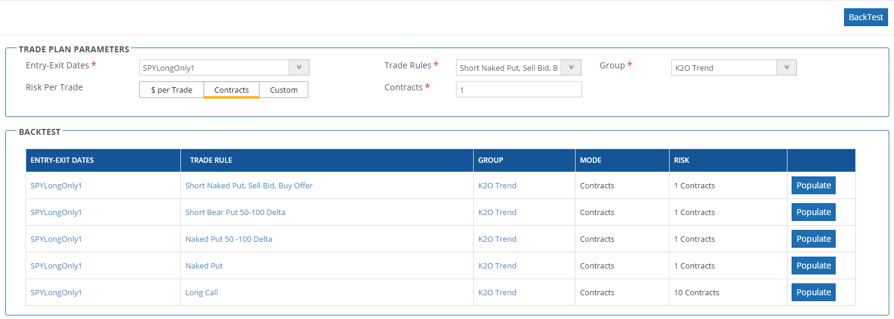
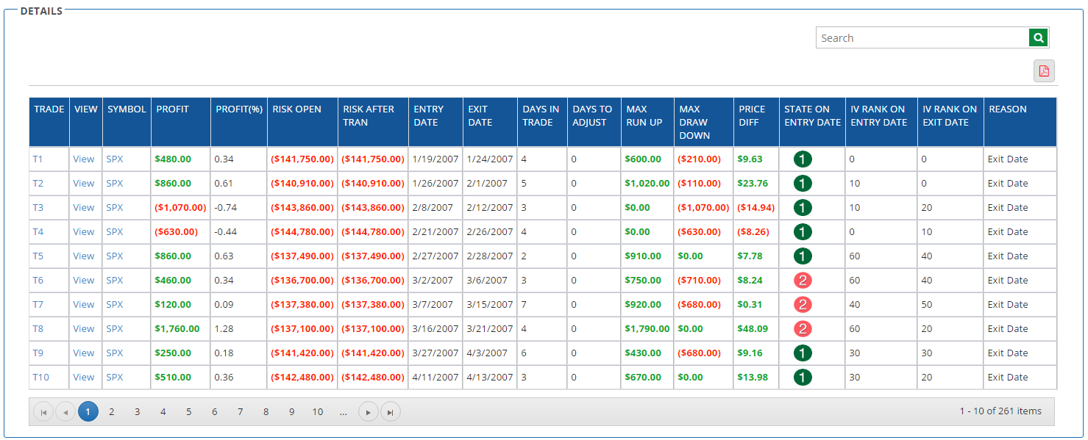
Part II: Key2Options
When back-testing, many combinations can be used, even for one specific strategy. For example, when back-testing a Naked Put strategy, a user can define what Delta is being used. Below is a screenshot of various Naked Put and Delta combinations I used in various back-tests.
As discussed earlier, if a put was sold outright on every date the TSL designed system went long, and bought back the put on each date the TSL designed got flat, it would have generated a system with a profit factor of 2.06.
A detailed view of each trade can be seen in the screenshot below. Key2Options allows the user to identify the profit (in both $ and % terms), number of days in the trade, as well as the maximum run up and run down, among other metrics.

Slide 5
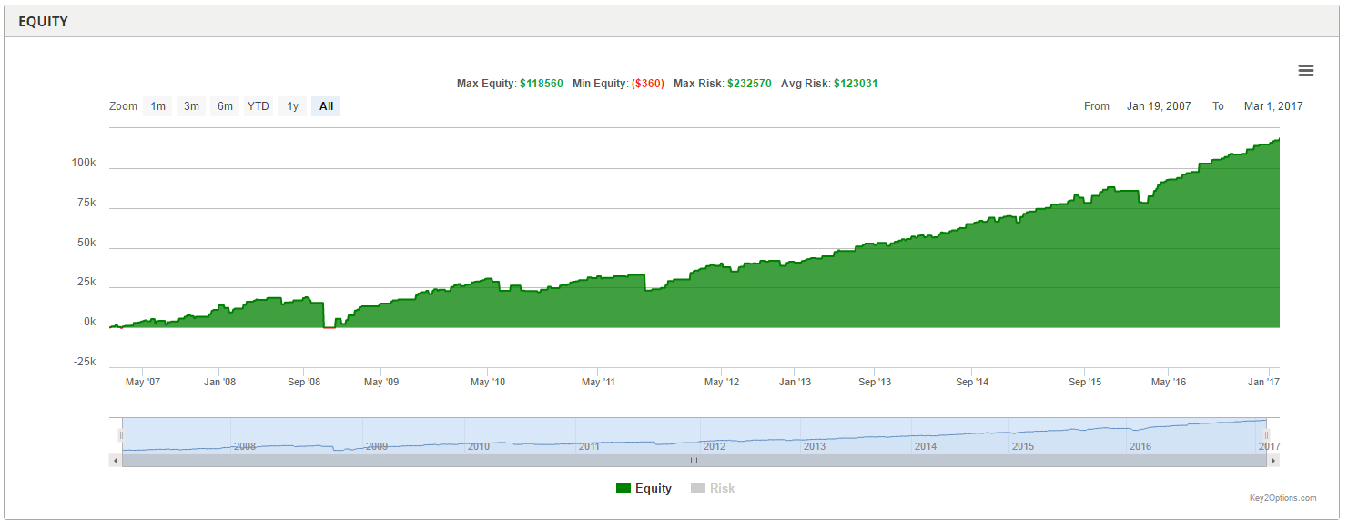
Part II: Key2Options
Below is a screenshot of the equity curve. Keep in mind this back-test is only a 10-year period (January 2007 – January 2017). The back-test generated $118,560 in profit.

Slide 6
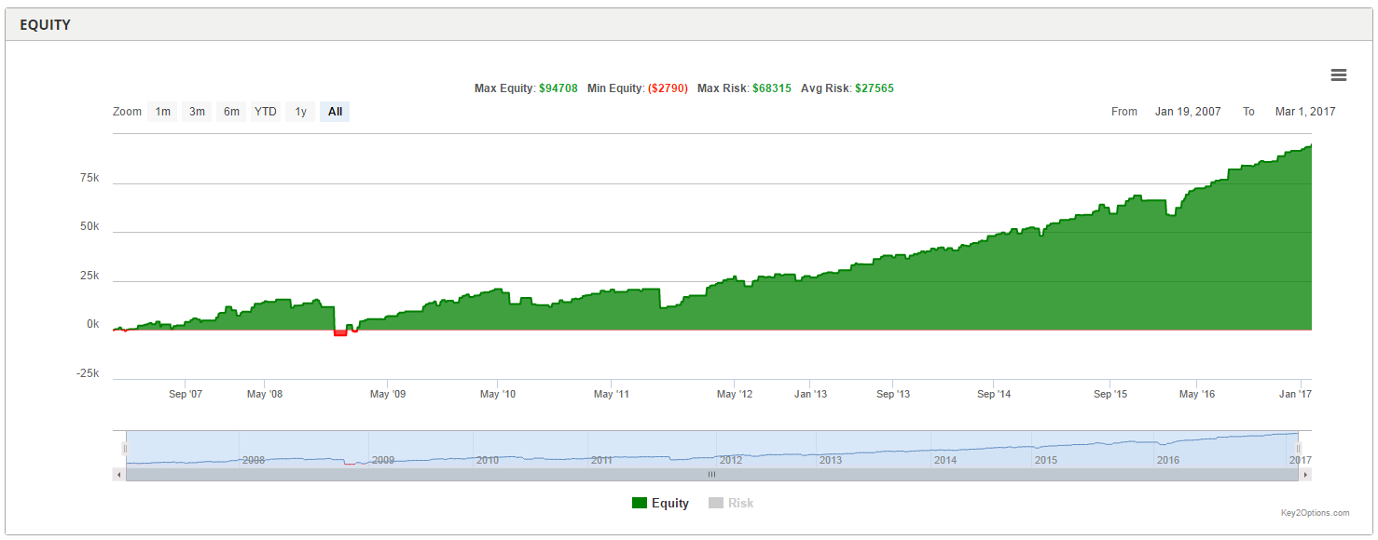
Part II: Key2Options
Here is a back-test of what most would consider a much more conservative approach, which is a bear put strategy. This reduces the risk of being short a put in an extended sell-off, and allows the trader to rest more comfortably knowing their maximum risk is capped.
Not surprisingly, the profit factor is reduced from 2.06 on the naked put strategy, to 1.83 on the bear put approach, mostly due to losses on the put which was purchased.
As expected, the equity curve doesn’t look as impressive with the bear put spread approach, but still very impressive.

Slide 7
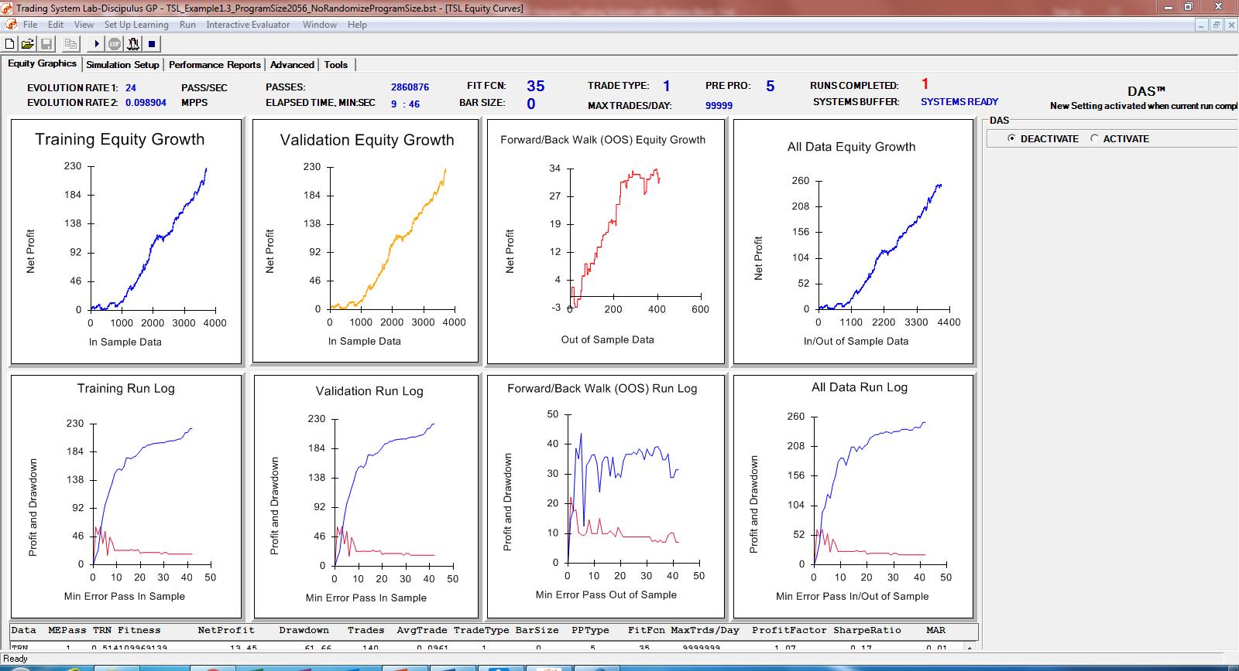
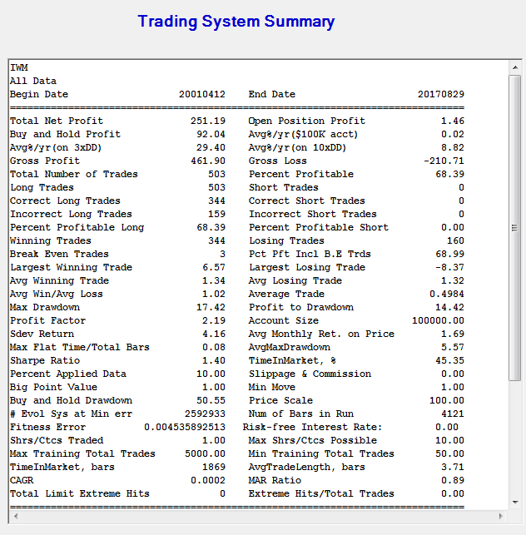
Additional Example: IWM (iShares Russell 2000 ETF)
Part I: System Generation in TSL
A long only system is first built within TSL using the ticker IWM. In roughly 10 minutes, and having TSL sift through over 2,800,000 system combinations, my final systems is evolved with an equity curve and statistical characteristics I consider satisfactory.
In the below screenshot, you can see the TSL designed long only system trades roughly 503 times from 2000-2017, a profit factor of 2.19, and has a winning percentage of 68.39%. Furthermore, over the back-test period roughly 251 IWM points of profit were generated, while a simple buy-and-hold approach would have generated roughly 92 IWM points of profit.
What must also be noted is the TSL designed system had a maximum drawdown of 17 IWM points, versus 50 for the simple buy-and-hold approach. Thus, TSL delivered superior risk adjusted returns.

Slide 8
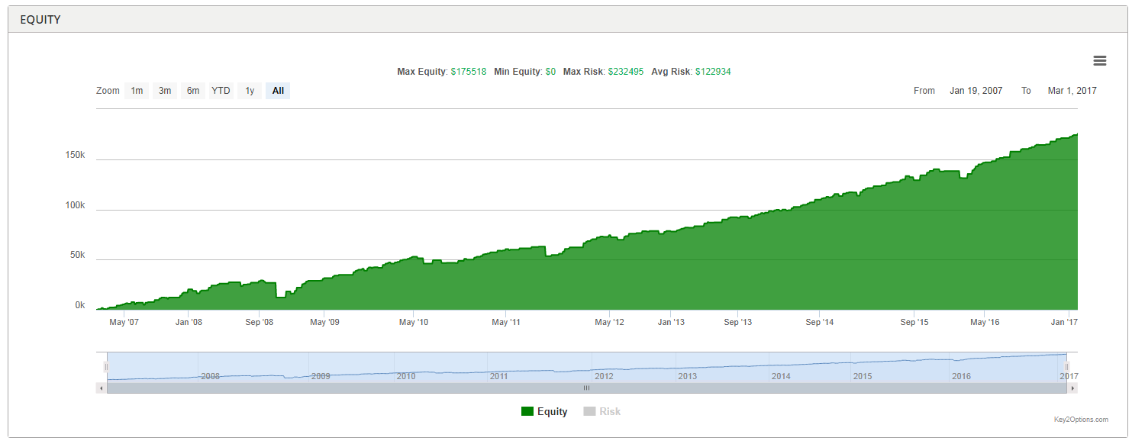
Part II: Key2Options
The system was built within TSL using PP5 (PP=PreProcessor) and TT1 (TT=Trade Type). I will be testing the IWM signals on actual historical IWM option data. TT1 (Trade at the close) was chosen because Key2Options uses closing prices when back-testing options. Since IWM ceases trading at the close of the NYSE (4:00 PM EST), and IWM options cease trading at 4:15 PM EST, there is theoretically a 15-minute window where the TSL designed system can be run in a trading platform, and trade the appropriate option contract in real-time, giving the trader a 15-minute window to execute their trade.
Below is a snap-shot of the final equity curve, using the steps previously mentioned:

Slide 9
Conclusion: TSL designed trading systems can be back-tested in the Key2Options platform quickly and easily, with no prior programming knowledge. Further strategies can be tested, such as outright long calls, or calendar spreads, to name just a few.

